Slide 1
Rehabilitation and Restorative Care
Chapter 21

Slide 2
Learning Objectives
Discuss rehabilitation and restorative care
Describe the importance of promoting independence and list ways that exercise improves health
Describe assistive devices and equipment
Explain care guidelines for prosthetic devices
Describe how to assist with range of motion exercises
Describe the benefits of deep breathing exercises

Slide 3
Rehabilitation & Restorative Care
When assisting in this process:
Be patient
Be positive and supportive
Focus on small tasks and accomplishments
Recognize that setbacks occur
Be sensitive
Encourage independence
Involve them in their care
Observe and report any increase or decrease in abilities
Change in attitude or motivation
Change in general health
Signs of depression or mood changes
Rehabilitation
Care given by specialists to restore or improve function after an illness or injury
Goals
Regain function or recover from an illness
Develop and promote independence
Help resident accept or adapt to the limitations of a disability
Restorative Care
Usually follows rehabilitation
Goal
Keep the resident at the level achieved by rehabilitative services

Slide 4
Promoting Independence & Improving Health
Promote Independence
Reduce physical and mental problems
Loss of self-esteem
Depression
Illnesses
Loss of independence & lack of mobility may lead to:
Constipation
Blood clots
Dulled senses
Muscle atrophy and contractures
Increased risk of pressure ulcers
Reposition every 2 hours
Regular activity and exercise help improve:
Quality and health of skin
Circulation
Strength
Sleep and relaxation
Mood
Self-esteem
Appetite
Elimination
Blood flow
Oxygen level

Slide 5
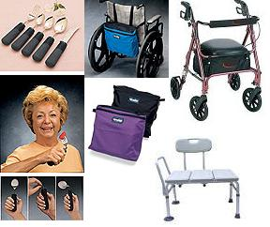
Assistive Devices & Equipment
Prosthesis
Replaces a body part that is missing or deformed because of an accident, injury, illness, or birth defect
Used to improve a person’s ability to function and/or to improve appearance
Examples
Artificial limbs
Hearing aid
Artificial eye
Dentures

Slide 6
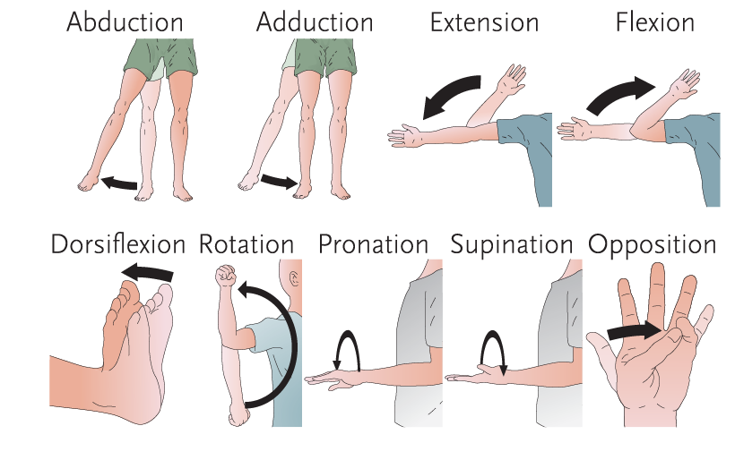
Range of Motion Exercises
ROM
PROM
AROM
AAROM
Range of Motion
Passive Range of Motion
Active Range of Motion
Active Assisted Range of Motion

Slide 7
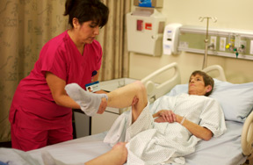
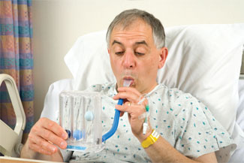
Assisting with Exercises
Skills video
ROM
Doctor’s order; care plan
Perform each exercise 3 times
Deep Breathing
Expands the lungs, clearing them of mucus and preventing infections
Paralyzed residents or post-abdominal surgery residents are encouraged to do these
Begin at the head and work downward
Move the joints gently, slow and smooth
STOP if the resident has pain; report to nurse
Incentive spirometer helps with this exercise

Slide 8
Review
Rehabilitation and restorative care
Promoting independence
Ways that exercise improves health
Assistive devices and equipment
Prosthetic devices
Range of motion exercises
Deep breathing exercises

