Slide 1
Special Care Skills
Chapter 22

Slide 2
Learning Objectives
Understand the types of residents who are in a subacute setting
Discuss reasons for and types of surgery, preoperative care, and postoperative care
List care guidelines for pulse oximetry and telemetry
Explain artificial airways, tracheostomy, and mechanical ventilation
Describe suctioning and signs of respiratory distress
Describe chest tubes and related care

Slide 3
Subacute Care
Acute Care
Long-Term Care
Subacute Care
Hospitals or Skilled Nursing Facilities
May need a higher level of care

Slide 4
Surgeries
Elective
Chosen by the patient
Planned in advance
Urgent
Must be performed for health reasons
Planned or scheduled in advance
Emergency
Unexpected and unscheduled surgery
Performed immediately to save a patient’s life or a limb

Slide 5
Preoperative & Postoperative Care
Preoperative Care
Physical and psychological preparation
Tasks may include:
Postoperative Care
Goal: prevent infections and promote healing
Tasks may include:
Follow NPO orders
Assist to bathroom
Call light within reach
Vital signs
Remove personal items
Gown, if required
ID bracelet
Return personal items
Vital signs
Reposition
Assist with deep breathing and coughing exercises
Apply anti-embolic hose or compression devices
Monitor surgical drains
Assist with elimination
Assist with ambulation as ordered
Monitor closely for complications

Slide 6
Oximetry & Telemetry
Oximetry
Telemetry
Measures blood oxygen level and pulse rate
Measures the heart rhythm and rate continuously
Normal 95-100%
Specially trained staff monitor and assess at all times

Slide 7
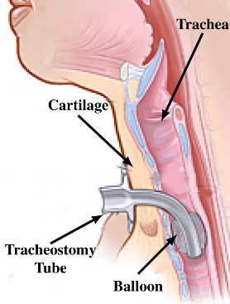
Artificial Airways
Artificial Airway
Tracheostomy
Plastic, metal or rubber device inserted into the respiratory tract to maintain and promote breathing
Intubation (method used to insert an artificial airway)
Surgically-created opening through the neck into the trachea
Guidelines for care:
Be supportive and responsive
Use alternate communication methods
Answer call lights promptly
Observe and report
Keep the stoma clean
Mechanical Ventilation
Machine that inflates and deflates the lungs
Unable to speak – may increase anxiety
Heavily sedated for comfort and anxiety
Speak to them and explain what you are doing when providing cares

Slide 8
Suctioning & Respiratory Distress
COUGH
SUCTION
Respiratory Distress
Gurgling sound
Difficulty breathing
Elevated respiratory rate
Pale, blue or gray skin around the eyes, mouth or nails
Flaring nostrils
Retracting
Sweating
wheezing

Slide 9
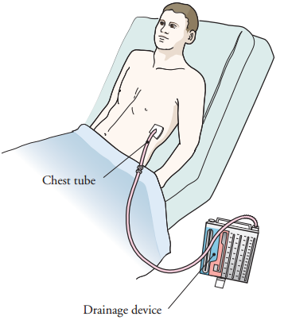
Chest Tubes
Hollow drainage tubes inserted into the chest
Drains air, blood, or other fluid that has collected inside the pleural cavity or space
Your tasks may include:
Vital signs
Report signs of respiratory distress
Keep the drainage system below the level of the chest
Make sure the drainage container remains upright and level at all times
Make sure the tubing is not kinked or disconnected
Observe drainage for color and amount
Provide rest periods
Measure I&O carefully
Be encouraging and patient
Allow full expansion of the lung

Slide 10
Review
Subacute care
Surgery
Pulse oximetry and telemetry
Artificial airways
Respiratory distress
Chest tubes

