Slide 1
Chapter 14: Basic nursing skills

Slide 2
Learning objectives
Explain the importance of monitoring vital signs
List guidelines for measuring body temperature
List guidelines for measuring pulse and respirations
Explain guidelines for measuring blood pressure
Describe guidelines for pain management
Explain the benefits of warm and cold applications
Discuss non-sterile and sterile dressings
Discuss guidelines for elastic bandages
List care guidelines for a resident who has an IV

Slide 3
Importance of monitoring vital signs
Temp. Site Fahrenheit Celsius
Mouth (oral) 97.6°–99.6° 36.5°–37.5°
Rectum (rectal) 98.6°–100.6° 37.0°–38.1°
Armpit (axilla) 96.6°–98.6° 36.0°–37.0°
Ear (tympanic) 96.6°–99.7° 35.8°–37.6°
Temporal Artery 97.2°–100.1° 36.2°–37.8°
Normal Pulse Rate: 60–100 beats per minute
Normal Respiratory Rate: 12–20 respirations per minute
Blood Pressure
Normal Systolic 100–119
Diastolic 60–79
Low Below 100/60
Prehypertensive Systolic 120–139
Diastolic 80–89
High 140/90 or above
Vital signs
Things to report
Normal Values
Notes:
Vital signs are measurements—temperature, pulse, respirations, blood pressure, pain level— that monitor the functioning of the vital organs of the body.
NAs monitor, document, and report on these vital signs:
Temperature
Pulse
Rate of respirations
Blood pressure
Pain level
An NA should report the following to the nurse:
Resident has a fever.
Respiratory or pulse rate is too rapid or too slow.
Resident’s blood pressure changes.
Pain is worsening or unrelieved.
Remember: NAs must always protect residents’ privacy when taking vital signs. They should provide privacy during procedures and not discuss vital signs within earshot of others.
Temp. Site Fahrenheit Celsius
Mouth (oral) 97.6°–99.6° 36.5°–37.5°
Rectum (rectal) 98.6°–100.6° 37.0°–38.1°
Armpit (axilla) 96.6°–98.6° 36.0°–37.0°
Ear (tympanic) 96.6°–99.7° 35.8°–37.6°
Temporal Artery 97.2°–100.1° 36.2°–37.8°
Normal Pulse Rate: 60–100 beats per minute
Normal Respiratory Rate: 12–20 respirations per minute
Blood Pressure
Normal Systolic 100–119
Diastolic 60–79
Low Below 100/60
Prehypertensive Systolic 120–139
Diastolic 80–89
High 140/90 or above

Slide 4
Skill: Measuring and recording an oral temperature
Do not take an oral temperature on a resident who has smoked, eaten or drunk fluids, chewed gum, or exercised in the last 10-20 minutes.
Equipment: clean mercury-free, digital, or electronic thermometer, gloves, disposable sheath/cover for thermometer, tissues, pen and paper
1. Identify yourself by name. Identify the resident by name.
2. Wash your hands.
3. Explain procedure to the resident. Speak clearly, slowly, and directly. Maintain face-to-face contact whenever possible.
4. Provide for resident’s privacy with curtain, screen, or door.
5. Put on gloves.
6. Mercury-free thermometer: Hold the thermometer by the stem. Before inserting it in the resident’s mouth, shake thermometer down to below the lowest number (at least below 96°F or 35°C). To shake the thermometer down, hold it at the end opposite the bulb with the thumb and two fingers. With a snapping motion of the wrist, shake the thermometer. Stand away from furniture and walls while doing so.
Digital thermometer: Put on the disposable sheath. Turn on thermometer and wait until ready sign appears.
Electronic thermometer: Remove the probe from base unit. Put on probe cover.
Continued on next slide
Notes:
NAs should remember these important points about body temperature:
Normal ranges and variations are listed on p. 225 in textbook.
Age, illness, stress, environment, exercise, and the circadian rhythm all affect temperature.
There are five sites.
Oral temperatures cannot be taken on someone who is unconscious, has recently had facial or oral surgery, is younger than 5 years old, is confused, is heavily sedated, is coughing, is being administered oxygen, has facial paralysis, or has a nasogastric tube.
Mercury-free thermometers are color-coded: green or blue for oral; red for rectal.
Digital thermometers are commonly used for oral, rectal, and axillary temps.
Disposable thermometers may be used. They are used once and then discarded.
Tympanic thermometers are fast and accurate.
Temporal artery thermometers measure heat over temporal artery with a gentle stroke or scan across the forehead.
Rectal temperatures are most accurate, but taking rectal temperatures can be dangerous in some residents.
Axillary temperatures are considered least accurate.
All thermometers must be cleaned between residents or protective covers must be used.
Do not take an oral temperature on a resident who has smoked, eaten or drunk fluids, chewed gum, or exercised in the last 10-20 minutes.
Equipment: clean mercury-free, digital, or electronic thermometer, gloves, disposable sheath/cover for thermometer, tissues, pen and paper
1. Identify yourself by name. Identify the resident by name.
2. Wash your hands.
3. Explain procedure to the resident. Speak clearly, slowly, and directly. Maintain face-to-face contact whenever possible.
4. Provide for resident’s privacy with curtain, screen, or door.
5. Put on gloves.
6. Mercury-free thermometer: Hold the thermometer by the stem. Before inserting it in the resident’s mouth, shake thermometer down to below the lowest number (at least below 96°F or 35°C). To shake the thermometer down, hold it at the end opposite the bulb with the thumb and two fingers. With a snapping motion of the wrist, shake the thermometer. Stand away from furniture and walls while doing so.
Digital thermometer: Put on the disposable sheath. Turn on thermometer and wait until ready sign appears.
Electronic thermometer: Remove the probe from base unit. Put on probe cover.
Continued on next slide

Slide 5
Skill: Measuring and recording an oral temperature (Continued)
7. Mercury-free thermometer: Put on disposable sheath if available. Insert bulb end of the thermometer into resident’s mouth, under tongue and to one side.
Digital thermometer: Insert the end of digital thermometer into resident’s mouth, under tongue and to one side.
Electronic thermometer: Insert the end of electronic thermometer into resident’s mouth, under tongue and to one side.
8. Mercury-free thermometer: Tell the resident to hold the thermometer in his mouth with lips closed. Assist as necessary. Resident should breathe through his nose. Ask resident not to bite down or to talk. Leave thermometer in place for at least three minutes.
Digital thermometer: Leave in place until thermometer blinks or beeps.
Electronic thermometer: Leave in place until you hear a tone or see a flashing or steady light.
9. Mercury-free thermometer: Remove the thermometer. Wipe with a tissue from stem to bulb or remove sheath. Dispose of the tissue or sheath. Hold the thermometer at eye level. Rotate until line appears, rolling the thermometer between your thumb and forefinger. Read the temperature. Remember the temperature reading.
Digital thermometer: Remove the thermometer. Read temperature on display screen. Remember the temperature reading.
Electronic thermometer: Read the temperature on the display screen. Remember the temperature reading. Remove the probe.
10. Mercury-free thermometer: Clean thermometer with soap and water. Rinse with clean water and dry. Return it to case.
Digital thermometer: Using a tissue, remove and dispose of sheath. Replace the thermometer in case.
Electronic thermometer: Press the eject button to discard the cover. Return the probe to the holder.
11. Remove and discard gloves.
12. Wash your hands.
13. Immediately record the temperature, date, time, and method used (oral).
14. Place call light within resident’s reach.
15. Report any changes in resident to the nurse.
Notes:
7. Mercury-free thermometer: Put on disposable sheath if available. Insert bulb end of the thermometer into resident’s mouth, under tongue and to one side.
Digital thermometer: Insert the end of digital thermometer into resident’s mouth, under tongue and to one side.
Electronic thermometer: Insert the end of electronic thermometer into resident’s mouth, under tongue and to one side.
8. Mercury-free thermometer: Tell the resident to hold the thermometer in his mouth with lips closed. Assist as necessary. Resident should breathe through his nose. Ask resident not to bite down or to talk. Leave thermometer in place for at least three minutes.
Digital thermometer: Leave in place until thermometer blinks or beeps.
Electronic thermometer: Leave in place until you hear a tone or see a flashing or steady light.
9. Mercury-free thermometer: Remove the thermometer. Wipe with a tissue from stem to bulb or remove sheath. Dispose of the tissue or sheath. Hold the thermometer at eye level. Rotate until line appears, rolling the thermometer between your thumb and forefinger. Read the temperature. Remember the temperature reading.
Digital thermometer: Remove the thermometer. Read temperature on display screen. Remember the temperature reading.
Electronic thermometer: Read the temperature on the display screen. Remember the temperature reading. Remove the probe.
10. Mercury-free thermometer: Clean thermometer with soap and water. Rinse with clean water and dry. Return it to case.
Digital thermometer: Using a tissue, remove and dispose of sheath. Replace the thermometer in case.
Electronic thermometer: Press the eject button to discard the cover. Return the probe to the holder.
11. Remove and discard gloves.
12. Wash your hands.
13. Immediately record the temperature, date, time, and method used (oral).
14. Place call light within resident’s reach.
15. Report any changes in resident to the nurse.

Slide 6
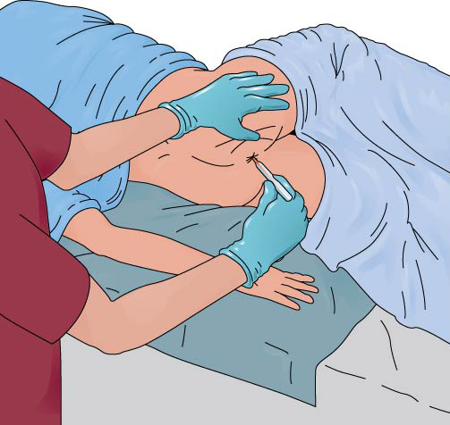
Skill: Measuring and recording a rectal temperature
Equipment: clean rectal mercury-free, digital, or electronic thermometer, lubricant, gloves, tissues, disposable sheath/cover, pen and paper
1. Identify yourself by name. Identify the resident by name.
2. Wash your hands.
3. Explain procedure to the resident. Speak clearly, slowly, and directly. Maintain face-to-face contact whenever possible.
4. Provide for resident’s privacy with curtain, screen, or door.
5. Adjust bed to a safe level, usually waist high. Lock bed wheels.
6. Help the resident to the left side-lying (Sims’) position.
7. Fold back the linens to expose only the rectal area.
8. Put on gloves.
9. Mercury-free thermometer: Hold thermometer by stem. Shake the thermometer down to below the lowest number.
Digital thermometer: Put on the disposable sheath. Turn on thermometer and wait until ready sign appears.
Electronic thermometer: Remove the probe from base unit. Put on probe cover.
10. Apply a small amount of lubricant to tip of bulb or probe cover (or apply pre-lubricated cover).
11. Separate the buttocks. Gently insert thermometer into rectum 1/2 to 1 inch. Stop if you meet resistance. Do not force the thermometer in.
Continued on next slide
Notes:
NAs should remember these important points about taking a rectal temperature:
May be necessary in the following situations:
Unconscious residents
Residents with poorly-fitted dentures or missing teeth
Anyone having trouble breathing through the nose
Mercury-free, digital, or electronic thermometers can be used.
NA must explain what he or she will do before starting.
Be reassuring.
NA must hold on to the thermometer at all times.
Gloves must be worn.
Thermometer must be lubricated for this procedure.
The privacy of the resident is important.
Equipment: clean rectal mercury-free, digital, or electronic thermometer, lubricant, gloves, tissues, disposable sheath/cover, pen and paper
1. Identify yourself by name. Identify the resident by name.
2. Wash your hands.
3. Explain procedure to the resident. Speak clearly, slowly, and directly. Maintain face-to-face contact whenever possible.
4. Provide for resident’s privacy with curtain, screen, or door.
5. Adjust bed to a safe level, usually waist high. Lock bed wheels.
6. Help the resident to the left side-lying (Sims’) position.
7. Fold back the linens to expose only the rectal area.
8. Put on gloves.
9. Mercury-free thermometer: Hold thermometer by stem. Shake the thermometer down to below the lowest number.
Digital thermometer: Put on the disposable sheath. Turn on thermometer and wait until ready sign appears.
Electronic thermometer: Remove the probe from base unit. Put on probe cover.
10. Apply a small amount of lubricant to tip of bulb or probe cover (or apply pre-lubricated cover).
11. Separate the buttocks. Gently insert thermometer into rectum 1/2 to 1 inch. Stop if you meet resistance. Do not force the thermometer in.
Continued on next slide

Slide 7
Skill: Measuring and recording a rectal temperature (Continued)
12. Replace the sheet over buttocks. Hold on to the thermometer at all times.
13. Mercury-free thermometer: Hold thermometer in place for at least three minutes.
Digital thermometer: Hold thermometer in place until thermometer blinks or beeps.
Electronic thermometer: Leave in place until you hear a tone or see a flashing or steady light.
14. Gently remove the thermometer. Wipe with tissue from stem to bulb or remove sheath. Discard tissue or sheath.
15. Read the thermometer at eye level as you would for an oral temperature. Remember the temperature reading.
16. Mercury-free thermometer: Clean thermometer with soap and water. Rinse with clean water and dry. Return it to case.
Digital thermometer: Clean thermometer according to policy. Replace the thermometer in case.
Electronic thermometer: Press the eject button to discard the cover. Return the probe to the holder.
17. Remove and discard gloves.
18. Wash your hands.
19. Assist the resident to a position of safety and comfort.
20. Immediately record the temperature, date, time, and method used (rectal).
21. Place call light within resident’s reach.
22. Report any changes in resident to the nurse.
Notes:
12. Replace the sheet over buttocks. Hold on to the thermometer at all times.
13. Mercury-free thermometer: Hold thermometer in place for at least three minutes.
Digital thermometer: Hold thermometer in place until thermometer blinks or beeps.
Electronic thermometer: Leave in place until you hear a tone or see a flashing or steady light.
14. Gently remove the thermometer. Wipe with tissue from stem to bulb or remove sheath. Discard tissue or sheath.
15. Read the thermometer at eye level as you would for an oral temperature. Remember the temperature reading.
16. Mercury-free thermometer: Clean thermometer with soap and water. Rinse with clean water and dry. Return it to case.
Digital thermometer: Clean thermometer according to policy. Replace the thermometer in case.
Electronic thermometer: Press the eject button to discard the cover. Return the probe to the holder.
17. Remove and discard gloves.
18. Wash your hands.
19. Assist the resident to a position of safety and comfort.
20. Immediately record the temperature, date, time, and method used (rectal).
21. Place call light within resident’s reach.
22. Report any changes in resident to the nurse.

Slide 8
Skill: Measuring and recording a tympanic temperature
Equipment: tympanic thermometer, gloves, disposable probe sheath/cover, pen and paper
1. Identify yourself by name. Identify the resident by name.
2. Wash your hands.
3. Explain procedure to the resident. Speak clearly, slowly, and directly. Maintain face-to-face contact whenever possible.
4. Provide for resident’s privacy with curtain, screen, or door.
5. Put on gloves.
6. Put a disposable sheath over earpiece of the thermometer.
7. Position the resident’s head so that the ear is in front of you. Straighten the ear canal by gently pulling up and back on the outside edge of the ear for an adult. Insert the covered probe into the ear canal and press the button.
8. Hold thermometer in place either for one second or until thermometer blinks or beeps (depends on model).
9. Read temperature. Remember the temperature reading.
10. Dispose of sheath. Return the thermometer to storage or to the battery charger if thermometer is rechargeable.
11. Remove and discard gloves.
12. Wash your hands.
13. Immediately record the temperature, date, time, and method used (tympanic).
14. Place call light within resident’s reach.
15. Report any changes in resident to the nurse.
Notes:
NAs should remember these important points about measuring tympanic and axillary temperatures:
Tympanic thermometers are fast and accurate.
The tympanic thermometer will only go into the ear ¼ - ½ inch.
Axillary temperatures are much less reliable but can be safer for confused, disoriented, or uncooperative residents or residents with dementia.
Equipment: tympanic thermometer, gloves, disposable probe sheath/cover, pen and paper
1. Identify yourself by name. Identify the resident by name.
2. Wash your hands.
3. Explain procedure to the resident. Speak clearly, slowly, and directly. Maintain face-to-face contact whenever possible.
4. Provide for resident’s privacy with curtain, screen, or door.
5. Put on gloves.
6. Put a disposable sheath over earpiece of the thermometer.
7. Position the resident’s head so that the ear is in front of you. Straighten the ear canal by gently pulling up and back on the outside edge of the ear for an adult. Insert the covered probe into the ear canal and press the button.
8. Hold thermometer in place either for one second or until thermometer blinks or beeps (depends on model).
9. Read temperature. Remember the temperature reading.
10. Dispose of sheath. Return the thermometer to storage or to the battery charger if thermometer is rechargeable.
11. Remove and discard gloves.
12. Wash your hands.
13. Immediately record the temperature, date, time, and method used (tympanic).
14. Place call light within resident’s reach.
15. Report any changes in resident to the nurse.

Slide 9
Skill: measuring and recording an axillary temperature
Equipment: clean mercury-free, digital, or electronic thermometer, gloves, tissues, disposable sheath/cover, pen and paper
1. Identify yourself by name. Identify the resident by name.
2. Wash your hands.
3. Explain procedure to the resident. Speak clearly, slowly, and directly. Maintain face-to-face contact whenever possible.
4. Provide for resident’s privacy with curtain, screen, or door.
5. Put on gloves.
6. Remove resident’s arm from sleeve of gown or shirt to allow skin contact with the end of the thermometer. Wipe axillary area with tissues before placing the thermometer.
7. Mercury-free thermometer: Hold the thermometer by the stem. Shake the thermometer down to below the lowest number.
Digital thermometer: Put on the disposable sheath. Turn on thermometer and wait until ready sign appears.
Electronic thermometer: Remove the probe from base unit. Put on probe cover.
Notes:
Equipment: clean mercury-free, digital, or electronic thermometer, gloves, tissues, disposable sheath/cover, pen and paper
1. Identify yourself by name. Identify the resident by name.
2. Wash your hands.
3. Explain procedure to the resident. Speak clearly, slowly, and directly. Maintain face-to-face contact whenever possible.
4. Provide for resident’s privacy with curtain, screen, or door.
5. Put on gloves.
6. Remove resident’s arm from sleeve of gown or shirt to allow skin contact with the end of the thermometer. Wipe axillary area with tissues before placing the thermometer.
7. Mercury-free thermometer: Hold the thermometer by the stem. Shake the thermometer down to below the lowest number.
Digital thermometer: Put on the disposable sheath. Turn on thermometer and wait until ready sign appears.
Electronic thermometer: Remove the probe from base unit. Put on probe cover.

Slide 10
Skill: measuring and recording an axillary temperature (Continued)
8. Position thermometer (bulb end for mercury-free) in center of the armpit. Fold resident’s arm over her chest.
9. Mercury-free thermometer: Hold the thermometer in place, with the arm close against the side, for eight to 10 minutes.
Digital thermometer: Leave in place until thermometer blinks or beeps.
Electronic thermometer: Leave in place until you hear a tone or see a flashing or steady light.
10. Mercury-free thermometer: Remove the thermometer. Wipe with a tissue from stem to bulb or remove sheath. Dispose of the tissue or sheath. Read the thermometer at eye level as you would for an oral temperature. Remember the temperature reading.
Digital thermometer: Remove the thermometer. Read temperature on display screen. Remember the temperature reading.
Electronic thermometer: Read the temperature on the display screen. Remember the temperature reading. Remove the probe.
11. Mercury-free thermometer: Clean thermometer with soap and water. Rinse with clean water and dry. Return it to case.
Digital thermometer: Using a tissue, remove and dispose of sheath. Replace the thermometer in case.
Electronic thermometer: Press the eject button to discard the cover. Return the probe to the holder.
12. Remove and discard gloves.
13. Wash your hands.
14. Put resident’s arm back into sleeve of gown.
15. Immediately record the temperature, date, time, and method used (axillary).
16. Place call light within resident’s reach.
17. Report any changes in resident to the nurse.
Notes:
8. Position thermometer (bulb end for mercury-free) in center of the armpit. Fold resident’s arm over her chest.
9. Mercury-free thermometer: Hold the thermometer in place, with the arm close against the side, for eight to 10 minutes.
Digital thermometer: Leave in place until thermometer blinks or beeps.
Electronic thermometer: Leave in place until you hear a tone or see a flashing or steady light.
10. Mercury-free thermometer: Remove the thermometer. Wipe with a tissue from stem to bulb or remove sheath. Dispose of the tissue or sheath. Read the thermometer at eye level as you would for an oral temperature. Remember the temperature reading.
Digital thermometer: Remove the thermometer. Read temperature on display screen. Remember the temperature reading.
Electronic thermometer: Read the temperature on the display screen. Remember the temperature reading. Remove the probe.
11. Mercury-free thermometer: Clean thermometer with soap and water. Rinse with clean water and dry. Return it to case.
Digital thermometer: Using a tissue, remove and dispose of sheath. Replace the thermometer in case.
Electronic thermometer: Press the eject button to discard the cover. Return the probe to the holder.
12. Remove and discard gloves.
13. Wash your hands.
14. Put resident’s arm back into sleeve of gown.
15. Immediately record the temperature, date, time, and method used (axillary).
16. Place call light within resident’s reach.
17. Report any changes in resident to the nurse.

Slide 11
Skill: measuring and recording apical pulse
Equipment: stethoscope, watch with second hand, alcohol wipes, pen and paper
1. Identify yourself by name. Identify the resident by name.
2. Wash your hands.
3. Explain procedure to the resident. Speak clearly, slowly, and directly. Maintain face-to-face contact whenever possible.
4. Provide for resident’s privacy with curtain, screen, or door.
5. Before using stethoscope, wipe diaphragm and earpieces with alcohol wipes.
6. Fit the earpieces of the stethoscope snugly in your ears. Place the flat metal diaphragm on the left side of the chest, just below the nipple. Listen for the heartbeat.
7. Use the second hand of your watch. Count the heartbeats for one minute. Each lubdub that you hear is counted as one beat. A normal heartbeat is rhythmical. Leave the stethoscope in place to count respirations (see procedure later in chapter).
8. Record pulse rate, date, time, and method used (apical). Note any irregularities in the rhythm.
9. Clean earpieces and diaphragm of stethoscope with alcohol wipes. Store stethoscope.
10. Wash your hands.
11. Place call light within resident’s reach.
12. Report any changes in resident to the nurse.
Notes:
Radial pulse is the pulse located on the inside of the wrist, where the radial artery runs just beneath the skin.
Brachial pulse is the pulse located inside the elbow, about one to one-and-a-half inches above the elbow.
Apical pulse is the pulse located on the left side of the chest, just below the nipple. This pulse is taken by listening with a stethoscope. A stethoscope is an instrument designed to listen to sounds within the body.
NAs should remember these important points about the pulse:
Pulse is the number of heartbeats per minute.
Pulse is commonly taken at the wrist where radial artery runs.
Normal rate is 60-100 beats per minute for adults.
Normal rate is 100-120 beats per minute for small children, as high as 120-140 for newborns.
Pulse may be affected by exercise, fear, anger, anxiety, heat, medications, and pain.
Rapid pulse may result from fever, infection or heart failure.
Slow/weak pulse may indicate dehydration, infection, or shock.
P. 233 in the textbook shows common pulse sites.
Equipment: stethoscope, watch with second hand, alcohol wipes, pen and paper
1. Identify yourself by name. Identify the resident by name.
2. Wash your hands.
3. Explain procedure to the resident. Speak clearly, slowly, and directly. Maintain face-to-face contact whenever possible.
4. Provide for resident’s privacy with curtain, screen, or door.
5. Before using stethoscope, wipe diaphragm and earpieces with alcohol wipes.
6. Fit the earpieces of the stethoscope snugly in your ears. Place the flat metal diaphragm on the left side of the chest, just below the nipple. Listen for the heartbeat.
7. Use the second hand of your watch. Count the heartbeats for one minute. Each lubdub that you hear is counted as one beat. A normal heartbeat is rhythmical. Leave the stethoscope in place to count respirations (see procedure later in chapter).
8. Record pulse rate, date, time, and method used (apical). Note any irregularities in the rhythm.
9. Clean earpieces and diaphragm of stethoscope with alcohol wipes. Store stethoscope.
10. Wash your hands.
11. Place call light within resident’s reach.
12. Report any changes in resident to the nurse.

Slide 12
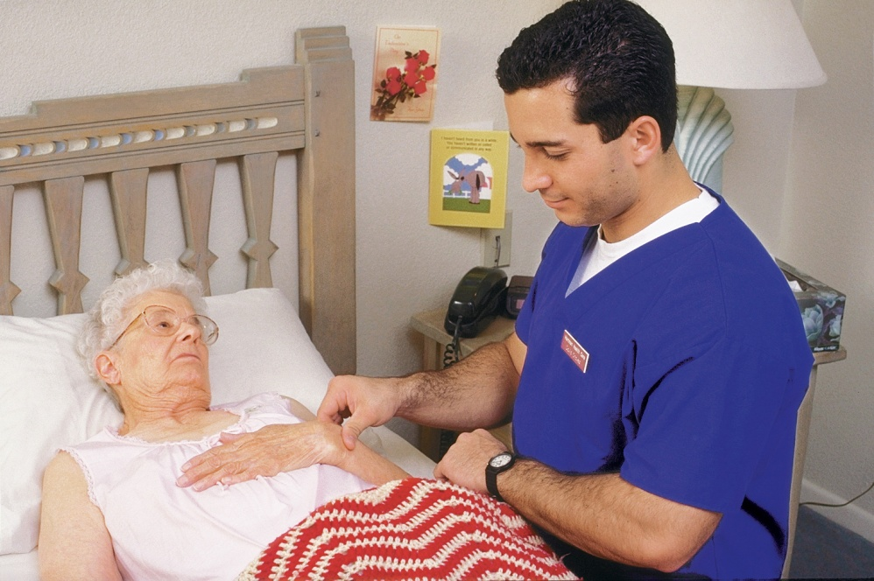
Measuring and recording radial pulse and counting and recording respirations
Equipment: watch with a second hand, pen and paper
1. Identify yourself by name. Identify the resident by name.
2. Wash your hands.
3. Explain procedure to the resident. Speak clearly, slowly, and directly. Maintain face-to-face contact whenever possible.
4. Provide for resident’s privacy with curtain, screen, or door.
5. Place fingertips on the thumb side of resident’s wrist. Locate pulse.
6. Using your watch, count the beats for one full minute.
7. Keeping your fingertips on the resident’s wrist, count respirations for one full minute. Observe the pattern and character of the resident’s breathing. Normal breathing is smooth and quiet. If you see signs of troubled, shallow, or noisy breathing, such as wheezing, report it.
8. Record pulse rate, date, time, and method used (radial). Record the respiratory rate and the pattern or character of breathing.
9. Place call light within resident’s reach.
10. Wash your hands.
11. Report to the nurse if the pulse is less than 60 beats per minute, over 100 beats per minute, if the rhythm is irregular, or if breathing is irregular.
Notes:
Respiration is the process of breathing air into the lungs and exhaling air out of the lungs. Inspiration is breathing in and expiration is exhaling air out of the lungs.
There are different words to explain how someone is breathing. Apnea is the absence of breathing, dyspnea is difficulty breathing, and eupnea is normal breathing. Orthopnea is shortness of breath when lying down that is relieved by sitting up. Tachypnea is rapid breathing and Cheyne-Stokes is alternating periods of slow, irregular breathing and rapid, shallow breathing.
NAs should remember these important points about respiration:
A breath includes both inspiration and expiration.
Normal rate for adults is 12 to 20 breaths per minute.
Normal rate for infants is 30 to 40 breaths per minute.
Do the counting immediately after taking the pulse.
Do not let person know you are counting breaths.
Equipment: watch with a second hand, pen and paper
1. Identify yourself by name. Identify the resident by name.
2. Wash your hands.
3. Explain procedure to the resident. Speak clearly, slowly, and directly. Maintain face-to-face contact whenever possible.
4. Provide for resident’s privacy with curtain, screen, or door.
5. Place fingertips on the thumb side of resident’s wrist. Locate pulse.
6. Using your watch, count the beats for one full minute.
7. Keeping your fingertips on the resident’s wrist, count respirations for one full minute. Observe the pattern and character of the resident’s breathing. Normal breathing is smooth and quiet. If you see signs of troubled, shallow, or noisy breathing, such as wheezing, report it.
8. Record pulse rate, date, time, and method used (radial). Record the respiratory rate and the pattern or character of breathing.
9. Place call light within resident’s reach.
10. Wash your hands.
11. Report to the nurse if the pulse is less than 60 beats per minute, over 100 beats per minute, if the rhythm is irregular, or if breathing is irregular.

Slide 13
Skill: measuring and recording blood pressure (one-step method)
Equipment: sphygmomanometer, stethoscope, alcohol wipes, pen and paper
1. Identify yourself by name. Identify the resident by name.
2. Wash your hands.
3. Explain procedure to the resident. Speak clearly, slowly, and directly. Maintain face-to-face contact whenever possible.
4. Provide for resident’s privacy with curtain, screen, or door.
5. Ask the resident to roll up his sleeve so that the upper arm is exposed. Do not measure blood pressure over clothing.
6. Position resident’s arm with palm up. The arm should be level with the heart.
7. With the valve open, squeeze the cuff. Make sure it is completely deflated.
8. Place blood pressure cuff snugly on resident’s upper arm. The center of the cuff with sensor/arrow is placed over the brachial artery (1-1½ inches above the elbow, toward inside of elbow).
9. Before using stethoscope, wipe diaphragm and earpieces with alcohol wipes.
10. Locate brachial pulse with fingertips.
11. Place diaphragm of stethoscope over brachial artery.
Continued on next slide
Notes:
When we measure blood pressure, we really are obtaining two pressure measurements – systolic and diastolic pressures. The systolic pressure is the first measurement of blood pressure; phase when the heart is at work, contracting and pushing the blood from the left ventricle of the heart. The diastolic pressure is the second measurement of blood pressure; phase when the heart relaxes or rests.
Hypertension (HTN) is high blood pressure, measuring 140/90 or higher. Prehypertension is a condition in which a person has a systolic measurement of 120–139 mm Hg and a diastolic measurement of 80–89 mm Hg; indicates that the person does not have high blood pressure now but is likely to have it in the future.
Hypotension is low blood pressure, measuring 100/60 or lower. A sphygmomanometer, or blood pressure cuff, is used to measure a blood pressure.
NAs should remember these important points about blood pressure:
The two parts of the BP are systolic (top number) and diastolic (bottom number).
Normal range is: S=100 to 119; D=60 to 79.
Blood pressure measurements between 120/80 and 139/89 were once considered normal but are now considered prehypertension.
Brachial artery at the elbow is used.
Equipment used is stethoscope and a sphygmomanometer.
An electronic sphygmomanometer may be available. If so, you will be trained in its use.
The cuff must first be completely deflated.
Never measure blood pressure on an arm that has an IV, a dialysis shunt, or any medical equipment. Avoid a side with a cast, recent trauma, paralysis from a stroke, burns, or mastectomy.
One-step method does not include getting an estimated systolic measurement before beginning. Two-step method does require getting an estimated systolic measurement.
Remember: It is not always easy to perfect the skill of hearing the first and last sounds when measuring blood pressure. Practice will help develop this skill.
If a nurse asks an NA to take an orthostatic blood pressure measurement, he is asking for measurements taken first with the resident lying down, then sitting up, and then standing.
Equipment: sphygmomanometer, stethoscope, alcohol wipes, pen and paper
1. Identify yourself by name. Identify the resident by name.
2. Wash your hands.
3. Explain procedure to the resident. Speak clearly, slowly, and directly. Maintain face-to-face contact whenever possible.
4. Provide for resident’s privacy with curtain, screen, or door.
5. Ask the resident to roll up his sleeve so that the upper arm is exposed. Do not measure blood pressure over clothing.
6. Position resident’s arm with palm up. The arm should be level with the heart.
7. With the valve open, squeeze the cuff. Make sure it is completely deflated.
8. Place blood pressure cuff snugly on resident’s upper arm. The center of the cuff with sensor/arrow is placed over the brachial artery (1-1½ inches above the elbow, toward inside of elbow).
9. Before using stethoscope, wipe diaphragm and earpieces with alcohol wipes.
10. Locate brachial pulse with fingertips.
11. Place diaphragm of stethoscope over brachial artery.
Continued on next slide

Slide 14
Skill: measuring and recording blood pressure (one-step method) (continued)
12. Place earpieces of stethoscope in your ears.
13. Close the valve (clockwise) until it stops. Do not over-tighten it.
14. Inflate cuff to 30 mmHg above the point at which the pulse is last heard or felt.
15. Open the valve slightly with thumb and index finger. Deflate cuff slowly. Releasing the valve slowly allows you to hear beats accurately.
16. Watch gauge. Listen for sound of the pulse.
17. Remember the reading at which the first pulse sound is heard. This is the systolic pressure.
18. Continue listening for a change or muffling of pulse sound. The point of change or the point the sound disappears is the diastolic pressure. Remember this reading.
19. Open the valve to deflate cuff completely. Remove cuff.
20. Record both the systolic and diastolic pressures. Write the numbers like a fraction, with the systolic reading on top and the diastolic reading on the bottom (for example: 120/80). Note which arm was used. Write RA for right arm and LA for left arm.
21. Wipe diaphragm and earpieces of stethoscope with alcohol wipes. Store equipment.
22. Place call light within resident’s reach.
23. Wash your hands.
24. Report any changes in resident to the nurse.
Notes:
12. Place earpieces of stethoscope in your ears.
13. Close the valve (clockwise) until it stops. Do not over-tighten it.
14. Inflate cuff to 30 mmHg above the point at which the pulse is last heard or felt.
15. Open the valve slightly with thumb and index finger. Deflate cuff slowly. Releasing the valve slowly allows you to hear beats accurately.
16. Watch gauge. Listen for sound of the pulse.
17. Remember the reading at which the first pulse sound is heard. This is the systolic pressure.
18. Continue listening for a change or muffling of pulse sound. The point of change or the point the sound disappears is the diastolic pressure. Remember this reading.
19. Open the valve to deflate cuff completely. Remove cuff.
20. Record both the systolic and diastolic pressures. Write the numbers like a fraction, with the systolic reading on top and the diastolic reading on the bottom (for example: 120/80). Note which arm was used. Write RA for right arm and LA for left arm.
21. Wipe diaphragm and earpieces of stethoscope with alcohol wipes. Store equipment.
22. Place call light within resident’s reach.
23. Wash your hands.
24. Report any changes in resident to the nurse.

Slide 15
Skill: measuring and recording blood pressure (two-step method)
Equipment: sphygmomanometer (blood pressure cuff), stethoscope, alcohol wipes, pen and paper
1. Identify yourself by name. Identify the resident by name.
2. Wash your hands.
3. Explain procedure to the resident. Speak clearly, slowly, and directly. Maintain face-to-face contact whenever possible.
4. Provide for resident’s privacy with curtain, screen, or door.
5. Ask the resident to roll up his sleeve so that the upper arm is exposed. Do not measure blood pressure over clothing.
6. Position resident’s arm with palm up. The arm should be level with the heart.
7. With the valve open, squeeze the cuff. Make sure it is completely deflated.
8. Place blood pressure cuff snugly on resident’s upper arm. The center of the cuff with sensor/arrow is placed over the brachial artery (1-1½ inches above the elbow, toward inside of elbow).
9. Locate the radial (wrist) pulse with your fingertips.
10. Close the valve (clockwise) until it stops. Inflate cuff while watching gauge.
11. Stop inflating when you can no longer feel the radial pulse. Note the reading. The number is an estimate of the systolic pressure. This estimate helps you not to inflate the cuff too high later in this procedure. Inflating the cuff too high is painful and may damage small blood vessels.
12. Open the valve to deflate cuff completely.
13. Write down the estimated systolic reading.
Continued on next slide
Notes:
Equipment: sphygmomanometer (blood pressure cuff), stethoscope, alcohol wipes, pen and paper
1. Identify yourself by name. Identify the resident by name.
2. Wash your hands.
3. Explain procedure to the resident. Speak clearly, slowly, and directly. Maintain face-to-face contact whenever possible.
4. Provide for resident’s privacy with curtain, screen, or door.
5. Ask the resident to roll up his sleeve so that the upper arm is exposed. Do not measure blood pressure over clothing.
6. Position resident’s arm with palm up. The arm should be level with the heart.
7. With the valve open, squeeze the cuff. Make sure it is completely deflated.
8. Place blood pressure cuff snugly on resident’s upper arm. The center of the cuff with sensor/arrow is placed over the brachial artery (1-1½ inches above the elbow, toward inside of elbow).
9. Locate the radial (wrist) pulse with your fingertips.
10. Close the valve (clockwise) until it stops. Inflate cuff while watching gauge.
11. Stop inflating when you can no longer feel the radial pulse. Note the reading. The number is an estimate of the systolic pressure. This estimate helps you not to inflate the cuff too high later in this procedure. Inflating the cuff too high is painful and may damage small blood vessels.
12. Open the valve to deflate cuff completely.
13. Write down the estimated systolic reading.
Continued on next slide

Slide 16
Skill: measuring and recording blood pressure (two-step method) (continued)
14. Before using the stethoscope, wipe diaphragm and earpieces of stethoscope with alcohol wipes.
15. Locate brachial pulse with fingertips.
16. Place the earpieces of the stethoscope in your ears.
17. Place the diaphragm of the stethoscope over the brachial artery.
18. Close the valve (clockwise) until it stops. Do not over-tighten it.
19. Inflate the cuff to 30 mmHg above your estimated systolic pressure.
20. Open the valve slightly with thumb and index finger. Deflate cuff slowly. Releasing the valve slowly allows you to hear beats accurately.
21. Watch the gauge. Listen for sound of the pulse.
22. Remember the reading at which the first pulse sound is heard. This is the systolic pressure.
23. Continue listening for a change or muffling of pulse sound. The point of change or the point that the sound disappears is the diastolic pressure. Remember this reading.
24. Open the valve to deflate cuff completely. Remove cuff.
25. Record both the systolic and diastolic pressures. Write the numbers like a fraction, with the systolic reading on top and the diastolic reading on the bottom (for example: 120/80). Note which arm was used. Write RA for right arm and LA for left arm.
26. Wipe diaphragm and earpieces of stethoscope with alcohol wipes. Store equipment.
27. Place call light within resident’s reach.
28. Wash your hands.
29. Report any changes in resident to the nurse.
Notes:
14. Before using the stethoscope, wipe diaphragm and earpieces of stethoscope with alcohol wipes.
15. Locate brachial pulse with fingertips.
16. Place the earpieces of the stethoscope in your ears.
17. Place the diaphragm of the stethoscope over the brachial artery.
18. Close the valve (clockwise) until it stops. Do not over-tighten it.
19. Inflate the cuff to 30 mmHg above your estimated systolic pressure.
20. Open the valve slightly with thumb and index finger. Deflate cuff slowly. Releasing the valve slowly allows you to hear beats accurately.
21. Watch the gauge. Listen for sound of the pulse.
22. Remember the reading at which the first pulse sound is heard. This is the systolic pressure.
23. Continue listening for a change or muffling of pulse sound. The point of change or the point that the sound disappears is the diastolic pressure. Remember this reading.
24. Open the valve to deflate cuff completely. Remove cuff.
25. Record both the systolic and diastolic pressures. Write the numbers like a fraction, with the systolic reading on top and the diastolic reading on the bottom (for example: 120/80). Note which arm was used. Write RA for right arm and LA for left arm.
26. Wipe diaphragm and earpieces of stethoscope with alcohol wipes. Store equipment.
27. Place call light within resident’s reach.
28. Wash your hands.
29. Report any changes in resident to the nurse.

Slide 17
Guidelines for pain management
Important points about pain
Signs and symptoms of pain to report
Ideas to help reduce pain
Notes:
It is important to remember the following points about pain:
It is as important to monitor as vital signs.
It is uncomfortable and an individual experience.
Take complaints of pain seriously.
Observe and report carefully since care plans are based on your reports.
Ask questions to get accurate information.
Pain is not a normal part of aging.
NAs should observe and report the following signs and symptoms associated with pain:
Increased pulse, respirations, and blood pressure
Sweating
Nausea
Vomiting
Tightening the jaw
Squeezing eyes shut
Holding or guarding a body part
Frowning
Grinding teeth Increased restlessness
Agitation or tension
Change in behavior
Crying
Sighing
Groaning
Breathing heavily
Rocking
Pacing
Repetitive movements
Difficulty moving or walking
NAs should remember the following ideas to help reduce residents’ pain:
Report complaints of pain or unrelieved pain immediately.
Gently position the body in proper alignment.
Give back rubs.
Ask if the resident would like to take a warm bath or shower.
Assist the resident to the bathroom or commode or offer the bedpan or urinal.
Encourage slow, deep breathing.
Provide a calm and quiet environment. Use soft music to distract the resident.
Be patient, caring, gentle, and responsive to residents who are in pain.

Slide 18
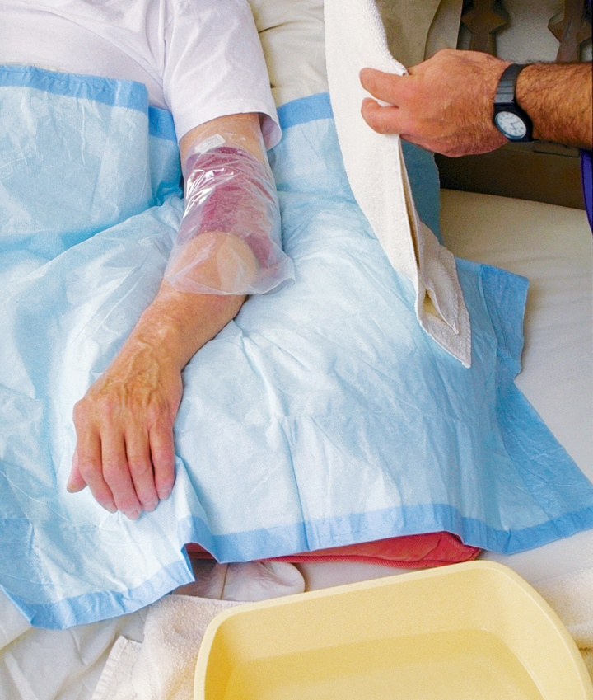
Skill: applying warm compresses
Equipment: washcloth or compress, plastic wrap, towel, basin, bath thermometer
1. Identify yourself by name. Identify the resident by name.
2. Wash your hands.
3. Explain procedure to the resident. Speak clearly, slowly, and directly. Maintain face-to-face contact whenever possible.
4. Provide for the resident’s privacy with curtain, screen, or door.
5. Fill basin one-half to two-thirds full with warm water. Test water temperature with thermometer or against the inside of your wrist to ensure it is safe. Water temperature should be no higher than 105°F. Have resident check water temperature. Adjust if necessary.
6. Soak the washcloth in the water and wring it out. Immediately apply it to the area needing a warm compress. Note the time. Quickly cover the washcloth with plastic wrap and the towel to keep it warm.
7. Check the area every five minutes. Remove the compress if the area is red or numb or if the resident complains of pain or discomfort. Change the compress if cooling occurs. Remove the compress after 20 minutes.
8. Make resident comfortable.
9. Place soiled towels in proper container.
10. Empty, rinse, and wipe basin. Return to proper storage. Discard plastic wrap.
11. Place call light within resident’s reach.
12. Wash your hands.
13. Report any changes in resident to the nurse.
14. Document procedure using facility guidelines.
Notes:
NAs should know the following points about warm and cold applications:
Heat relieves pain and muscular tension, reduces swelling, elevates temperature in the tissues, and increases blood flow, bringing more oxygen and nutrients to tissues.
Cold stops bleeding, prevents swelling, reduces pain, and helps bring down high fevers.
Moisture strengthens the effect of heat and cold.
Observe area for redness, pain, blisters, or numbness. Report any of these to the nurse. This may indicate tissue damage.
Equipment: washcloth or compress, plastic wrap, towel, basin, bath thermometer
1. Identify yourself by name. Identify the resident by name.
2. Wash your hands.
3. Explain procedure to the resident. Speak clearly, slowly, and directly. Maintain face-to-face contact whenever possible.
4. Provide for the resident’s privacy with curtain, screen, or door.
5. Fill basin one-half to two-thirds full with warm water. Test water temperature with thermometer or against the inside of your wrist to ensure it is safe. Water temperature should be no higher than 105°F. Have resident check water temperature. Adjust if necessary.
6. Soak the washcloth in the water and wring it out. Immediately apply it to the area needing a warm compress. Note the time. Quickly cover the washcloth with plastic wrap and the towel to keep it warm.
7. Check the area every five minutes. Remove the compress if the area is red or numb or if the resident complains of pain or discomfort. Change the compress if cooling occurs. Remove the compress after 20 minutes.
8. Make resident comfortable.
9. Place soiled towels in proper container.
10. Empty, rinse, and wipe basin. Return to proper storage. Discard plastic wrap.
11. Place call light within resident’s reach.
12. Wash your hands.
13. Report any changes in resident to the nurse.
14. Document procedure using facility guidelines.

Slide 19
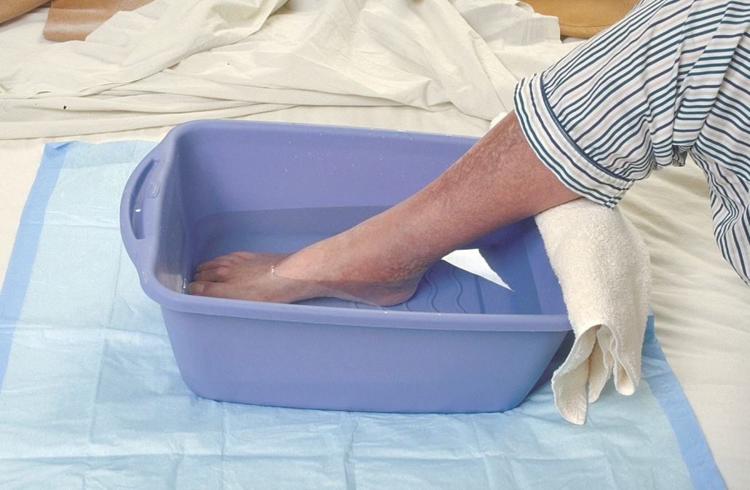
Skill: Administering warm soaks
Equipment: towel, basin, bath thermometer, bath blanket
1. Identify yourself by name. Identify the resident by name.
2. Wash your hands.
3. Explain procedure to the resident. Speak clearly, slowly, and directly. Maintain face-to-face contact whenever possible.
4. Provide for the resident’s privacy with curtain, screen, or door.
5. Fill the basin half full of warm water. Test water temperature with thermometer or against the inside of your wrist to ensure it is safe. Water temperature should be no higher than 105°F. Have resident check water temperature. Adjust if necessary.
6. Immerse the body part in the basin. Pad the edge of the basin with a towel. Use a bath blanket to cover the resident if needed for extra warmth.
7. Check water temperature every five minutes. Add hot water as needed to maintain the temperature. Never add water hotter than 105°F to avoid burns. To prevent burns, ask the resident not to add hot water. Observe the area for redness. Discontinue the soak if the resident has pain or discomfort.
8. Soak for 15 to 20 minutes or as ordered.
9. Remove basin. Use the towel to dry resident.
10. Make resident comfortable.
11. Place soiled towel in proper container.
12. Empty, rinse, and wipe basin. Return to proper storage.
13. Place call light within resident’s reach.
14. Wash your hands.
15. Report any changes in resident to the nurse.
16. Document procedure using facility guidelines.
Notes:
Equipment: towel, basin, bath thermometer, bath blanket
1. Identify yourself by name. Identify the resident by name.
2. Wash your hands.
3. Explain procedure to the resident. Speak clearly, slowly, and directly. Maintain face-to-face contact whenever possible.
4. Provide for the resident’s privacy with curtain, screen, or door.
5. Fill the basin half full of warm water. Test water temperature with thermometer or against the inside of your wrist to ensure it is safe. Water temperature should be no higher than 105°F. Have resident check water temperature. Adjust if necessary.
6. Immerse the body part in the basin. Pad the edge of the basin with a towel. Use a bath blanket to cover the resident if needed for extra warmth.
7. Check water temperature every five minutes. Add hot water as needed to maintain the temperature. Never add water hotter than 105°F to avoid burns. To prevent burns, ask the resident not to add hot water. Observe the area for redness. Discontinue the soak if the resident has pain or discomfort.
8. Soak for 15 to 20 minutes or as ordered.
9. Remove basin. Use the towel to dry resident.
10. Make resident comfortable.
11. Place soiled towel in proper container.
12. Empty, rinse, and wipe basin. Return to proper storage.
13. Place call light within resident’s reach.
14. Wash your hands.
15. Report any changes in resident to the nurse.

Slide 20
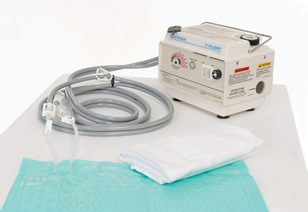
Skill: applying an aquamatic k-pad
Equipment: Aquamatic K-Pad and control unit, covering for pad, distilled water
1. Identify yourself by name. Identify the resident by name.
2. Wash your hands.
3. Explain procedure to the resident. Speak clearly, slowly, and directly. Maintain face-to-face contact whenever possible.
4. Provide for the resident’s privacy during procedure with curtain, screen, or door.
5. Place the control unit on the bedside table. Make sure cords are not frayed or damaged. Check that tubing between pad and unit is intact.
6. Remove cover of control unit to check level of water. If it is low, fill it with distilled water to the fill line.
7. Put the cover of control unit back in place.
8. Plug unit in and turn pad on. Temperature should have been pre-set. If it was not, check with the nurse for proper temperature.
9. Place the pad in the cover. Do not pin the pad to the cover.
10. Uncover area to be treated. Place the covered pad on the area. Note the time. Make sure the tubing is not hanging below the bed. It should be coiled on the bed.
11. Return and check area every five minutes. Remove the pad if the area is red or numb or if the resident reports pain or discomfort.
12. Check water level and refill when necessary.
13. Remove pad after 20 minutes.
14. Make resident comfortable.
15. Clean and store supplies.
16. Place call light within resident’s reach.
17. Wash your hands.
18. Report any changes in resident to the nurse.
19. Document procedure using facility guidelines.
Notes:
Equipment: Aquamatic K-Pad and control unit, covering for pad, distilled water
1. Identify yourself by name. Identify the resident by name.
2. Wash your hands.
3. Explain procedure to the resident. Speak clearly, slowly, and directly. Maintain face-to-face contact whenever possible.
4. Provide for the resident’s privacy during procedure with curtain, screen, or door.
5. Place the control unit on the bedside table. Make sure cords are not frayed or damaged. Check that tubing between pad and unit is intact.
6. Remove cover of control unit to check level of water. If it is low, fill it with distilled water to the fill line.
7. Put the cover of control unit back in place.
8. Plug unit in and turn pad on. Temperature should have been pre-set. If it was not, check with the nurse for proper temperature.
9. Place the pad in the cover. Do not pin the pad to the cover.
10. Uncover area to be treated. Place the covered pad on the area. Note the time. Make sure the tubing is not hanging below the bed. It should be coiled on the bed.
11. Return and check area every five minutes. Remove the pad if the area is red or numb or if the resident reports pain or discomfort.
12. Check water level and refill when necessary.
13. Remove pad after 20 minutes.
14. Make resident comfortable.
15. Clean and store supplies.
16. Place call light within resident’s reach.
17. Wash your hands.
18. Report any changes in resident to the nurse.
19. Document procedure using facility guidelines.

Slide 21
Skill: Assisting with a sitz bath
Equipment: disposable sitz bath, bath thermometer, towels, gloves
1. Identify yourself by name. Identify the resident by name.
2. Wash your hands.
3. Explain procedure to the resident. Speak clearly, slowly, and directly. Maintain face-to-face contact whenever possible.
4. Provide for the resident’s privacy with curtain, screen, or door.
5. Put on gloves.
6. Fill the sitz bath two-thirds full with warm water. Place the disposable sitz bath on the toilet seat. Check the water temperature using the bath thermometer. Water temperature should be no higher than 105°F. If the sitz bath is being used to help relieve pain and to stimulate circulation, the water temperature may need to be higher. Follow instructions in the care plan.
7. Help the resident undress and sit on the sitz bath. A valve on the tubing connected to the bag allows the resident or you to refill the water in the sitz bath again with warm water.
8. You may be required to stay with the resident for safety reasons. If you leave the room, check on the resident every five minutes to make sure he is not dizzy or weak. Stay with a resident who seems unsteady.
9. Help the resident off of the sitz bath in 20 minutes. Provide towels and help with dressing if needed.
10. Make sure resident is comfortable.
11. Place soiled towel in proper container. Clean and store supplies.
12. Remove and discard gloves.
13. Wash your hands.
14. Place call light within resident’s reach.
15. Report any changes in resident to the nurse.
16. Document procedure using facility guidelines.
Notes:
A sitz bath is a warm soak of the perineal area to clean perineal wounds and reduce inflammation and pain.
Remember: The following procedure for a sitz bath is for the use of a disposable/commercial type sitz basin that sits on the commode. There is also a sitz chair that is used in facilities. The resident must be checked every five minutes and not left in the water for longer than 20 minutes.
Equipment: disposable sitz bath, bath thermometer, towels, gloves
1. Identify yourself by name. Identify the resident by name.
2. Wash your hands.
3. Explain procedure to the resident. Speak clearly, slowly, and directly. Maintain face-to-face contact whenever possible.
4. Provide for the resident’s privacy with curtain, screen, or door.
5. Put on gloves.
6. Fill the sitz bath two-thirds full with warm water. Place the disposable sitz bath on the toilet seat. Check the water temperature using the bath thermometer. Water temperature should be no higher than 105°F. If the sitz bath is being used to help relieve pain and to stimulate circulation, the water temperature may need to be higher. Follow instructions in the care plan.
7. Help the resident undress and sit on the sitz bath. A valve on the tubing connected to the bag allows the resident or you to refill the water in the sitz bath again with warm water.
8. You may be required to stay with the resident for safety reasons. If you leave the room, check on the resident every five minutes to make sure he is not dizzy or weak. Stay with a resident who seems unsteady.
9. Help the resident off of the sitz bath in 20 minutes. Provide towels and help with dressing if needed.
10. Make sure resident is comfortable.
11. Place soiled towel in proper container. Clean and store supplies.
12. Remove and discard gloves.
13. Wash your hands.
14. Place call light within resident’s reach.
15. Report any changes in resident to the nurse.
16. Document procedure using facility guidelines.

Slide 22
Skill: applying ice packs
Equipment: cold pack or sealable plastic bag and crushed ice, towel to cover pack or bag
1. Identify yourself by name. Identify the resident by name.
2. Wash your hands.
3. Explain procedure to the resident. Speak clearly, slowly, and directly. Maintain face-to-face contact whenever possible.
4. Provide for the resident’s privacy with curtain, screen, or door.
5. Fill plastic bag one-half to two-thirds full with crushed ice. Seal bag. Remove excess air. Cover bag with towel.
6. Apply bag to the area as ordered. Note the time. Use another towel to cover bag if it is too cold.
7. Check the area after ten minutes for blisters or pale, white, or gray skin. Stop treatment if resident reports numbness or pain.
8. Remove ice after 20 minutes or as ordered.
9. Make resident comfortable.
10. Place soiled towel in proper container. Discard supplies or store in freezer if ordered.
11. Place call light within resident’s reach.
12. Wash your hands.
13. Report any changes in resident to the nurse.
14. Document procedure using facility guidelines.
Notes:
Equipment: cold pack or sealable plastic bag and crushed ice, towel to cover pack or bag
1. Identify yourself by name. Identify the resident by name.
2. Wash your hands.
3. Explain procedure to the resident. Speak clearly, slowly, and directly. Maintain face-to-face contact whenever possible.
4. Provide for the resident’s privacy with curtain, screen, or door.
5. Fill plastic bag one-half to two-thirds full with crushed ice. Seal bag. Remove excess air. Cover bag with towel.
6. Apply bag to the area as ordered. Note the time. Use another towel to cover bag if it is too cold.
7. Check the area after ten minutes for blisters or pale, white, or gray skin. Stop treatment if resident reports numbness or pain.
8. Remove ice after 20 minutes or as ordered.
9. Make resident comfortable.
10. Place soiled towel in proper container. Discard supplies or store in freezer if ordered.
11. Place call light within resident’s reach.
12. Wash your hands.
13. Report any changes in resident to the nurse.
14. Document procedure using facility guidelines.

Slide 23
Skill: Applying cold compresses
Equipment: basin filled with water and ice, two washcloths, disposable bed protector, towels
1. Identify yourself by name. Identify the resident by name.
2. Wash your hands.
3. Explain procedure to the resident. Speak clearly, slowly, and directly. Maintain face-to-face contact whenever possible.
4. Provide for the resident’s privacy with curtain, screen, or door.
5. Place bed protector under area to be treated. Rinse washcloth in basin and wring out. Cover the area to be treated with a towel. Apply cold washcloth to the area as directed. Change washcloths often to keep area cold.
6. Check the area after five minutes for blisters or pale, white, or gray skin. Stop treatment if resident complains of numbness or pain.
7. Remove compresses after 20 minutes or as ordered in the care plan. Give resident towels as needed to dry the area.
8. Make resident comfortable.
9. Place towels in proper container. Empty, clean, and store basin.
10. Place call light within resident’s reach.
11. Wash your hands.
12. Report any changes in resident to the nurse.
13. Document procedure using facility guidelines.
Notes:
Equipment: basin filled with water and ice, two washcloths, disposable bed protector, towels
1. Identify yourself by name. Identify the resident by name.
2. Wash your hands.
3. Explain procedure to the resident. Speak clearly, slowly, and directly. Maintain face-to-face contact whenever possible.
4. Provide for the resident’s privacy with curtain, screen, or door.
5. Place bed protector under area to be treated. Rinse washcloth in basin and wring out. Cover the area to be treated with a towel. Apply cold washcloth to the area as directed. Change washcloths often to keep area cold.
6. Check the area after five minutes for blisters or pale, white, or gray skin. Stop treatment if resident complains of numbness or pain.
7. Remove compresses after 20 minutes or as ordered in the care plan. Give resident towels as needed to dry the area.
8. Make resident comfortable.
9. Place towels in proper container. Empty, clean, and store basin.
10. Place call light within resident’s reach.
11. Wash your hands.
12. Report any changes in resident to the nurse.
13. Document procedure using facility guidelines.

Slide 24
Skill: changing a dry dressing using non-sterile technique
Equipment: package of square gauze dressings, adhesive tape, scissors, 2 pairs of gloves
1. Identify yourself by name. Identify the resident by name.
2. Wash your hands.
3. Explain procedure to the resident. Speak clearly, slowly, and directly. Maintain face-to-face contact whenever possible.
4. Provide for resident’s privacy with curtain, screen, or door.
5. With scissors, cut pieces of tape long enough to secure the dressing. Hang tape on the edge of a table within reach. Open the four-inch gauze square package without touching the gauze. Place the opened package on a flat surface.
6. Put on gloves.
7. Remove soiled dressing by gently peeling tape toward the wound. Lift dressing off the wound. Do not drag it over the wound. Observe the dressing for any odor or drainage. Notice the color and size of the wound. Dispose of used dressing in proper container.
8. Remove and discard gloves. Wash your hands.
9. Put on new gloves. Touching only outer edges of new four-inch gauze, remove it from the package. Apply it to the wound. Tape gauze in place. Secure it firmly.
10. Discard supplies.
11. Remove and discard gloves.
12. Wash your hands.
13. Make resident comfortable.
14. Place call light within resident’s reach.
15. Report any changes in resident to the nurse.
16. Document procedure using facility guidelines.
Notes:
NAs should remember these points about dressings:
NAs do not change sterile dressings, which cover open or draining wounds.
Non-sterile dressings are for wounds that have less chance of infection.
NAs may help with non-sterile dressing changes.
Equipment: package of square gauze dressings, adhesive tape, scissors, 2 pairs of gloves
1. Identify yourself by name. Identify the resident by name.
2. Wash your hands.
3. Explain procedure to the resident. Speak clearly, slowly, and directly. Maintain face-to-face contact whenever possible.
4. Provide for resident’s privacy with curtain, screen, or door.
5. With scissors, cut pieces of tape long enough to secure the dressing. Hang tape on the edge of a table within reach. Open the four-inch gauze square package without touching the gauze. Place the opened package on a flat surface.
6. Put on gloves.
7. Remove soiled dressing by gently peeling tape toward the wound. Lift dressing off the wound. Do not drag it over the wound. Observe the dressing for any odor or drainage. Notice the color and size of the wound. Dispose of used dressing in proper container.
8. Remove and discard gloves. Wash your hands.
9. Put on new gloves. Touching only outer edges of new four-inch gauze, remove it from the package. Apply it to the wound. Tape gauze in place. Secure it firmly.
10. Discard supplies.
11. Remove and discard gloves.
12. Wash your hands.
13. Make resident comfortable.
14. Place call light within resident’s reach.
15. Report any changes in resident to the nurse.
16. Document procedure using facility guidelines.
NAs do not change sterile dressings, but they may be asked to do any of the following:
Gather and store equipment and supplies
Observe and report about the dressing site
Clean the equipment
Position the resident
Cut tape
Dispose of soiled dressing
These supplies may be needed when changing a sterile dressing:
Special gauze
Abdominal pads (ABDs)
Cotton bandages (e.g., Kerlix or Kling)
Binders
Medical-grade adhesive tape (e.g., Montgomery Straps)
NAs should remember the following information about sterile dressings:
If wrapper is torn, the supply is no longer sterile.
Wrapper cannot be opened and closed again.
If wrapper is wet or seems to have been wet, it is no longer sterile.
If supply is past expiration date, it is no longer sterile.
If there is any doubt whether something is sterile it should not be used.
Aides should be professional and not show discomfort.
Observe for and report the following:
Skin that has changed color
Scab that has come off
Bleeding
Swelling
Odor
Drainage

Slide 25
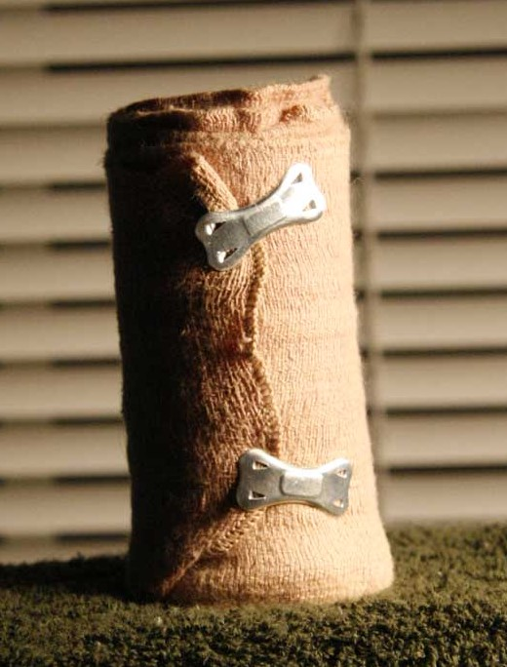
Guidelines for elastic bandages
Important points regarding elastic bandages
Guidelines for elastic bandages
Notes:
NAs should remember the following about elastic bandages:
Elastic bandages hold dressings in place, secure splints, and support and protect body parts. They may decrease swelling from an injury.
NAs may assist with use of an elastic bandage.
Some states allow NAs to apply and remove elastic bandages. Follow your facility’s policy.
NAs should know these guidelines for elastic bandages:
Keep area clean and dry.
Apply snugly enough to control bleeding but make sure not to wrap too tightly, as this can decrease circulation.
Wrap bandage evenly.
Do not tie the bandage; use special clips.
Remove bandage as often as indicated in care plan.
Check bandage often to be sure it does not become wrinkled or loose.
Fifteen minutes after bandage is applied, check for signs of poor circulation; loosen if any of these signs are present:
Swelling
Bluish (cyanotic) skin
Shiny, tight skin
Skin that is cold to the touch
Sores
Numbness
Tingling
Pain or discomfort

Slide 26
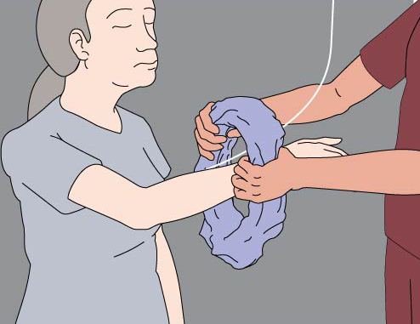
Skill: assisting in changing clothes for a resident who has an iv
Equipment: clean clothes
1. Identify yourself by name. Identify the resident by name.
2. Wash your hands.
3. Explain procedure to the resident. Speak clearly, slowly, and directly. Maintain face-to-face contact whenever possible.
4. Provide for resident’s privacy with curtain, screen, or door.
5. Adjust bed to lowest position. Lock bed wheels.
6. Assist resident to sitting position with feet flat on the floor.
7. Ask the resident to remove the arm without the IV from clothing. Assist as necessary.
8. Help the resident gather the clothing on the arm with the IV. Carefully lift the clothing over the IV site and move it up the tubing toward the IV bag.
9. Lift the IV bag off of its pole, keeping it higher than the IV site. Carefully slide clothing over the bag. Place bag back on the pole.
Notes:
Intravenous (IV) means into a vein. NAs never insert or remove IV lines. NAs do not provide care for the IV site.
NAs only observe a resident’s IV site for changes or problems and report if any of the following happens:
Needle falls out
Tubing disconnects
Dressing is loose
Blood is in tubing
Site is swollen or discolored
Resident complains of pain
IV bag is broken or fluid level does not decrease
IV fluid is not dripping or is leaking
IV fluid is nearly gone
Pump beeps
Pump is dropped
It is important that NAs never do any of the following:
Measure blood pressure on an arm with an IV
Get the site wet
Lower the IV bag below the IV site
Leave the tubing kinked
Touch the clamp
Pull on or catch the tubing on anything
Disconnect IV from pump or turn off alarm
Equipment: clean clothes
1. Identify yourself by name. Identify the resident by name.
2. Wash your hands.
3. Explain procedure to the resident. Speak clearly, slowly, and directly. Maintain face-to-face contact whenever possible.
4. Provide for resident’s privacy with curtain, screen, or door.
5. Adjust bed to lowest position. Lock bed wheels.
6. Assist resident to sitting position with feet flat on the floor.
7. Ask the resident to remove the arm without the IV from clothing. Assist as necessary.
8. Help the resident gather the clothing on the arm with the IV. Carefully lift the clothing over the IV site and move it up the tubing toward the IV bag.
9. Lift the IV bag off of its pole, keeping it higher than the IV site. Carefully slide clothing over the bag. Place bag back on the pole.

Slide 27
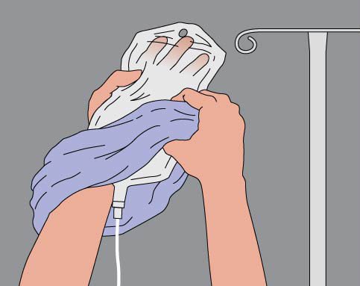
Skill: assisting in changing clothes for a resident who has an iv (continued)
10. Set the used clothing aside to be placed with soiled laundry.
11. Gather the sleeve of the clean clothing.
12. Lift the IV bag off its pole and, keeping it higher than the IV site, carefully slide the clothing over the bag. Place the IV bag back on the pole.
13. Carefully move the clean clothing down the IV tubing, over the IV site, and onto the resident’s arm.
14. Have the resident put her other arm in the clothing. Assist as necessary.
15. Check that the IV is dripping properly. Make sure none of the tubing is dislodged and that the IV site dressing is in place. Make sure tubing is not kinked after you are finished.
16. Assist the resident with changing the rest of her clothing as necessary.
17. Place soiled clothes in proper container.
18. Make resident comfortable.
19. Place call light within resident’s reach.
20. Wash your hands.
21. Report any changes in resident to the nurse.
22. Document procedure using facility guidelines.
Notes:
10. Set the used clothing aside to be placed with soiled laundry.
11. Gather the sleeve of the clean clothing.
12. Lift the IV bag off its pole and, keeping it higher than the IV site, carefully slide the clothing over the bag. Place the IV bag back on the pole.
13. Carefully move the clean clothing down the IV tubing, over the IV site, and onto the resident’s arm.
14. Have the resident put her other arm in the clothing. Assist as necessary.
15. Check that the IV is dripping properly. Make sure none of the tubing is dislodged and that the IV site dressing is in place. Make sure tubing is not kinked after you are finished.
16. Assist the resident with changing the rest of her clothing as necessary.
17. Place soiled clothes in proper container.
18. Make resident comfortable.
19. Place call light within resident’s reach.
20. Wash your hands.
21. Report any changes in resident to the nurse.

Slide 28
Guidelines for Oxygen therapy
Oxygen therapy
Oxygen concentrator
Nasal cannula
Oxygen tank guidelines
Liquid oxygen guidelines
Oxygen concentrator guidelines
Notes:
Oxygen therapy is the administration of oxygen to increase the supply of oxygen to the lungs.
An oxygen concentrator is a box-like device that changes air in the room into air with more oxygen.
A nasal cannula is a device used to deliver oxygen, which consists of a piece of plastic tubing that fits around the face and is secured by a strap that goes over the ears and around the back of the head.
NAs should know the following about oxygen tanks:
Measure and record pulse and respirations before and after oxygen use to see if there are changes.
Flow meter should be set at amount stated in care plan. Report to nurse if it is not. Do not adjust the level yourself.
Make sure humidifying bottle is filled with sterile water and attached correctly. Wash according to care plan or equipment supplier’s instructions.
Change nasal cannula when ordered.
Make sure tank is secured and will not tip.
NAs should know the following about liquid oxygen:
Turn off supply valves when reservoir is not in use.
Do not tip reservoir on its side.
Make sure reservoir is not in a closet, cupboard, or closed-in space.
Do not cover reservoir with anything.
When lifting, use both hands. Do not roll it or walk it on edge.
Do not touch frosted parts of equipment. Liquid oxygen can cause frostbite. Report leaks.
NAs should know the following about oxygen concentrators:
Measure and record pulse and respirations before and after oxygen use to see if there are changes.
Concentrator dial must be set at rate indicated in care plan. Report to nurse if it is not. Do not adjust the level yourself.
Make sure humidifying bottle is filled with sterile water and attached correctly.
Make sure concentrator is in a well-ventilated area, at least six inches from a wall. Brush off filter daily.
Remember: Some residents who use oxygen may also use a humidifier. NAs should follow the care plan’s instructions for cleaning and care of the humidifier.

Slide 29
Review
Explain the importance of monitoring vital signs
List guidelines for measuring body temperature
List guidelines for measuring pulse and respirations
Explain guidelines for measuring blood pressure
Describe guidelines for pain management
Explain the benefits of warm and cold applications
Discuss non-sterile and sterile dressings
Discuss guidelines for elastic bandages
List care guidelines for a resident who has an IV
Notes:
In this chapter we discussed the importance of monitoring vital signs and provided guidelines for measuring and recording body temperature, pulse, respirations, and blood pressure. Pain management was discussed and ways the NA can help with pain management were outlines. Benefits of warm and cold applications and related procedures were discussed, and the NA’s role in non-sterile and sterile dressing changes was discussed. Guidelines were provided for elastic bandages and care of a resident with an IV.

