Slide 1
Emergency Care and Disaster Preparation
Chapter 7

Slide 2
Lesson Objectives
Demonstrate how to recognize and respond to medical emergencies
Demonstrate knowledge of first aid procedures
Describe disaster guidelines

Slide 3
Recognition and Response
Assess the situation
Assess the victim
Call for help
Remain calm
Document
Calling EMS
Phone number and address
Person’s condition
Your name and position
Details of any first aid given

Slide 4
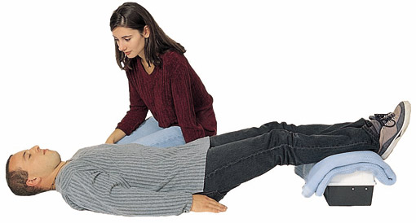
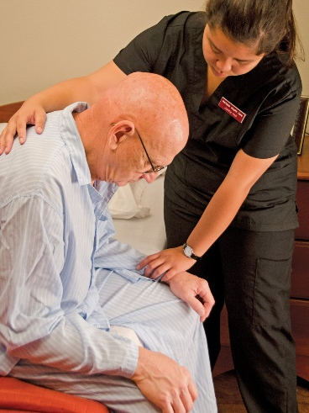
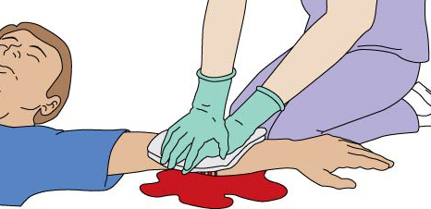
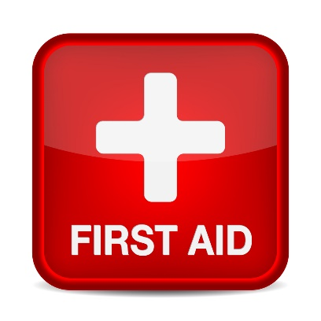
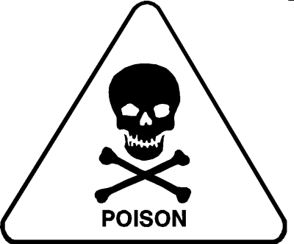
First Aid
Choking
Shock
Syncope
Bleeding
Epistaxis
Poisoning
Emesis
C
P
R

Slide 5
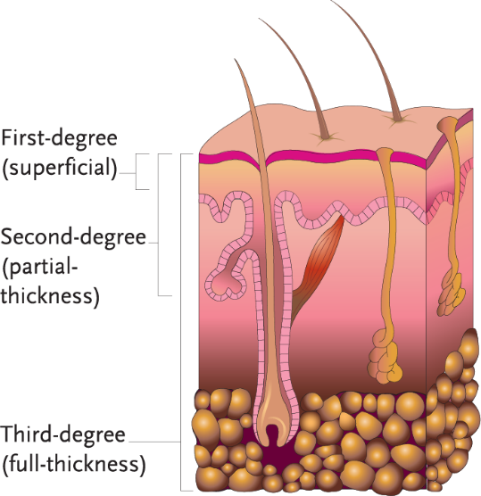
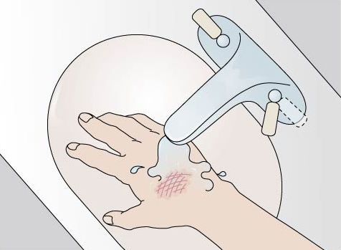
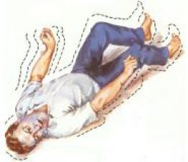
First Aid (continued)
Burns
Diabetic Ketoacidosis (DKA)
Hyperglycemia
Insulin Reaction
Hypoglycemia
Myocardial Infarction (MI)
Cerebral Vascular Accident (CVA)
Seizures
Falls
Hyperglycemia (DKA)
Hypoglycemia (IR)
↑ thirst, ↑ urination, sweet/fruity breath, weak, tired, dry skin
Weak, headache, trembling, confusion, cold/clammy skin, nervous

Slide 6
Disasters
General guidelines
Remain calm
Exits and stairways
Alarms and extinguishers
Know the appropriate action
Stay informed

Slide 7
Review
Medical emergencies
First aid procedures
Disaster guidelines

