Slide 1
The Nursing Assistant and the Care Team
Chapter 2

Slide 2
Learning Objectives
Identify the members of the care team and describe how the care team works together to provide care, including the nursing assistant’s role
Explain professionalism and list examples of professional behavior, including proper personal grooming habits
Explain the chain of command and scope of practice
Discuss the resident care plan and explain its purpose
Describe the nursing process
Describe The Five Rights of Delegation
Demonstrate how to manage time and assignments

Slide 3
Members of the Care Team
(C)NA
RN
LPN/LVN
MD/DO
PT/OT
SLP
RDT
MSW
Activities Director
Resident
Resident’s Family

Slide 4
Nursing Assistant’s Role
DO
DON’T
Perform assigned nursing tasks
Provide personal care or assist with self-care
Observe and report changes in resident’s condition
Chart/document important information about the resident
Insert or remove tubes
Change sterile dressings
Give tube feedings
Give medications unless trained and permitted by your facility

Slide 5
Professionalism
Compassionate
Caring, concerned, considerate, understanding, empathetic and sympathetic
Honest
Residents and employers need to be able to trust you
Tactful
Sensitivity and appropriate interaction
Conscientious
Alert, observant, accurate, and responsible
Dependable
Arrive to work on time, help peers when needed
Respectful
Honor individuality of residents and care team
Unprejudiced
Tolerant
Quality care regardless of different backgrounds
Respect others’ beliefs and practices without judgement

Slide 6
Personal Grooming Habits

Slide 7
Chain of Command
Administrator
Head of Medical Services (MD)
Director of Nursing
Other Services
PT/OT/SLT
Assistant DON
Staff Development Coordinator
Nursing Supervisor
Charge Nurse
Staff Nurse (RN/LPN)
CNA

Slide 8
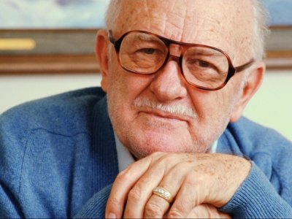
Scope of Practice Scenarios
Mr. Emery’s daughter has just asked you to tell them what Dr. Cooper’s new treatment plan is for their father.
The charge nurse just asked you to go change Mr. Gregory’s sterile dressing because it is draining and she is tied up with another resident.
The charge nurse has just handed you Mrs. French’s Tylenol and asked you to bring it to her and see that she takes it.
Your friend has asked you how you like working as a C.N.A. She wants to know if you can prescribe her some medication to help her sleep.

Slide 9
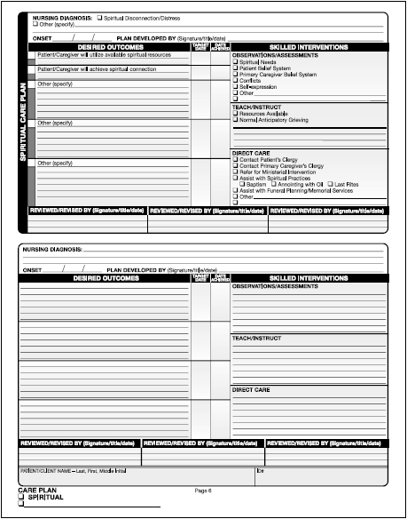
Resident Care Plan

Slide 10
Nursing Process
Assessment
Diagnosis
Planning
Implementation
Evaluation

Slide 11
The Five Rights of Delegation
Right Task
Right Circumstance
Right Person
Right Direction/Communication
Right Supervision/Evaluation

Slide 12
Time and Assignment Management
Plan ahead
Prioritize
Make a schedule
Combine activities
Get help

Slide 13
Review
Members of the care team
Nursing Assistant’s role
Professionalism
Personal grooming habits
Chain of command and scope of practice
Resident care plan
Nursing process
The Five Rights of Delegation
Time and Assignment management

