Slide 1
Caring for Your Career and Yourself
Chapter 24

Slide 2
Learning Objectives
Discuss different types of careers in the healthcare field
Explain how to find a job and write a resume
Discuss completing an effective job application and interview techniques
Discuss how to manage and resolve conflict
Discuss certification and explain the state’s registry
Describe continuing education
Define stress and stressors, ways to manage stress

Slide 3
Types of Careers in the Healthcare Field
CNAs
HHAs
PCTs
Nurses
PAs
Doctors
PT/OT/ST
DIRECT SERVICE
OTHER POSITIONS
Diagnostic services
Administrative and support staff
Complementary or alternative healthcare fields

Slide 4
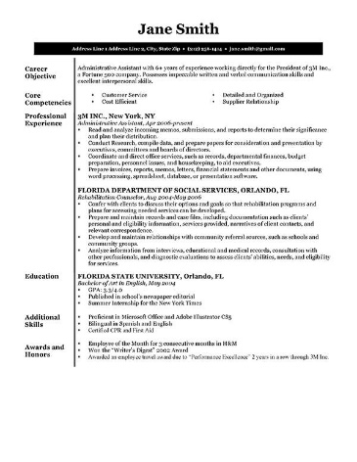
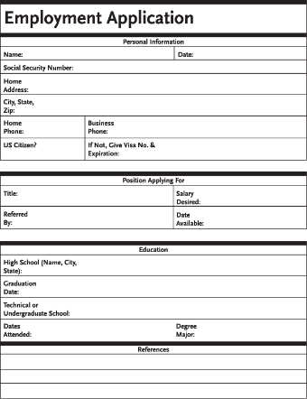
Finding & Applying for a Job
Documentation
Identification
Proof of legal ability to work in the US
Credentials
Reference letters
Resume
Include
Education
Experience
Special skills
Memberships
Volunteer work
Contact details
Brief and clear – 1 PAGE
Nice, plain paper
Cover letter
Application
Fill it out carefully and neatly
NEVER lie
Fill in all blanks
N/A
Criminal background check
Internet
Classified ads
State or local Department of Social Services
Instructor

Slide 5
Interview Techniques
Do’s
Look professional, neat and appropriate
Arrive 10-15 minutes early
Don’ts
Wear perfume or cologne
Smoke beforehand
Introduce yourself
Answer questions clearly and completely
Make eye contact
Avoid slang
Sit up and straight
Look happy to be there
Eat or drink in an interview
Bring friends or children with you
Relax and be confident
Be positive when answering questions
Make it clear you are willing to work
Complain about any previous jobs
Thank them for their time

Slide 6
Conflict Resolution & Criticism
Job description
Guidelines for resolving conflict
Plan to discuss the conflict at the right time and in the right place
Do NOT interrupt
Do NOT get emotional
Check your body language
Maintain eye contact and lean forward slightly
Keep focus on the issue at hand
Be prepared to brainstorm solutions and to compromise
Criticism
Constructive criticism
Intended to help you improve
You can respond by asking for details and suggestions, apologize and move on
Hostile criticism
Angry and negative
Your best response is “I’m sorry you are disappointed” and nothing more
Allow them to calm down before discussing things further
2 weeks
Evaluation

Slide 7
Certification
OBRA
75 hours
Initial training
12 hours
Continuing education
In-services
State Registry

Slide 8
Stress
Stress
State of being frightened, excited, confused, in danger, or irritated
Stressor
Something that causes stress
Positive or negative
Managing Stress
Eat healthy
Exercise
Sleep
Drink only in moderation
Do not smoke
Relax
Work-related Stress
Seek appropriate resources
NEVER discuss your stress with residents or their family
VALUE
CONGRATULATIONS!

Slide 9
Review
Healthcare careers
Finding a job
Writing a resume
Job applications
Interview techniques
Managing and resolving conflict
Certification and state registry
Continuing education
Stress

