Slide 1
Communication and Cultural Diversity
Chapter 4

Slide 2
Learning Objectives
Define communication and explain verbal and nonverbal communication
Identify barriers to communication
Explain how to use communication to develop effective relationships
List guidelines for communicating with residents with special needs
Explain how to observe and report accurately using objective and subjective information
Explain how to communicate with the care team including an accurate resident status report
Explain documentation and incident reporting

Slide 3
Communication
“How are you?”
“Fine, and you?”
Sender sends message
Receiver receives message
Receiver provides feedback

Slide 4
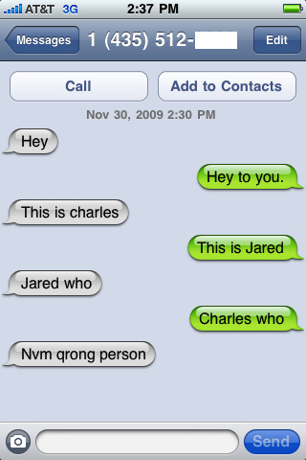
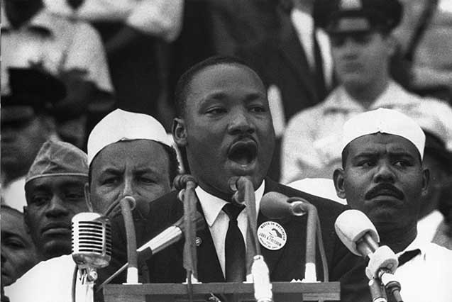
Verbal and Nonverbal Communication
Verbal communication
Nonverbal communication

Slide 5
Barriers to Communication
Resident does not hear or understand
Face residents directly
Speak slowly and clearly
Resident is difficult to understand
Be patient
Ask resident to repeat or explain
Use of words that are not understood or appropriate
Medical terminology, slang or clichés
Profanity
Asking “why” or yes/no questions
People may feel defensive
Advice
Can limit communication
Medical advice is not within the CNA scope of practice
Personal advice is not appropriate
Language
Speak slowly and clearly, keeping messages short and simple
Be patient and stay calm
Non-verbal
Be aware of your body language and watch the resident’s
Ask about any incongruences between verbal and nonverbal
Culture
Space, touch, eye contact
Be sensitive

Slide 6
Communication and Relationships
Be an active listener
Talk directly to the resident
Respectful subject matter
Understand and accept religion and cultural preferences
Don’t talk down to residents or families
Be empathetic
Communication aids
Resident call system
Don’t ignore requests

Slide 7
Communicating with Residents with Special Needs
Visually impaired
Identify yourself
Proper lighting
Hearing impaired
Noise
Speaking
CVA or stroke
Questions
Verbal/Nonverbal
Imaginary clock
Picture cards
Time
Combative residents
Calm and patient
Safety
Support

Slide 8
Observe and Report
Objective Data
Subjective Data

Slide 9
Communicating within the Care Team
Keep the nurse informed
Communicate with other care team members
Always respect residents’ privacy
Be careful with communication
Ask the nurse
Use the chain of command to voice complaints
Medical terminology
Telephone communication

Slide 10
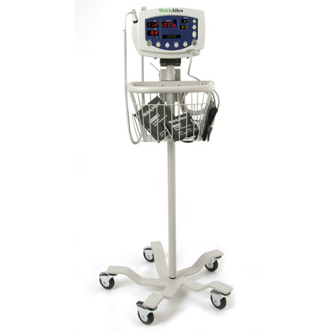
Reporting a Resident’s Status

Slide 11
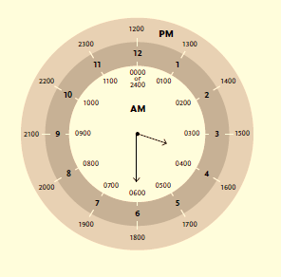
Documentation
When?
IMMEDIATELY after care is given
What?
Facts, not opinions
How?
Neatly with black ink
Who?
The person giving the care
Where?
In the resident’s medical chart
Signature at the end
Be brief and clear
Why?
Guarantees clear and complete communication
Provides legal record of treatment
Protects YOU and your employer
Provides current record of resident’s status
HIPAA Reminder

Slide 12
Incident Reporting
Incidents
Falls
Damage
Mistakes in care
Requests outside scope of practice
Sexual advances or remarks
Unsafe or uncomfortable situations
Injuries
Blood or body fluids exposure
Reporting
Tell what happened
Tell how the person tolerated the incident
Describe action taken
Include suggestions for change
State facts only
Do NOT write about the incident report on the medical record
Sentinel Event

Slide 13
Review
Communication process
Communication barriers
Communicating in relationships
Communicating with residents with special needs
Accurately observing and reporting
Communicating with the care team
Documentation and incident reporting

