Slide 1
Legal and Ethical Issues
Chapter 3

Slide 2
Learning Objectives
Define the terms ethics and laws and list examples of legal and ethical behavior
Explain the Omnibus Budget Reconciliation Act (OBRA)
Explain Residents’ Rights, their importance and how to promote or advocate for them
Discuss abuse and neglect and explain how to report abuse and neglect
Describe what happens when a complaint of abuse is made against a nursing assistant
Explain HIPAA and list ways to protect residents’ privacy
Explain the Patient Self-Determination Act (PSDA) and discuss advance directives

Slide 3
Ethics & Laws
Ethics
Laws
Ethical & Legal
Honesty
Privacy
Report observations, incidents, and abuse
Follow the care plan, your assignments, and your scope of practice
Follow safety rules
Document accurately and promptly
Do not accept gifts or tips
Do not get involved

Slide 4
Omnibus Budget Reconciliation Act (OBRA)
Reports of poor care and abuse in LTC facilities
OBRA passed in 1987
Minimum standards for nursing assistant training
75 hours training
Competency Evaluation
12 hours in-service per year
MDS (Minimum Data Set)

Slide 5
Residents’ Rights
Quality of life
Fully informed
Participate in their own care
Make independent choices
Privacy and confidentiality
Dignity, respect, and freedom
Security of possessions
Informed consent

Slide 6
Abuse & Neglect
Abuse is the purposeful mistreatment that causes physical, mental, or emotional pain or injury to someone
Neglect is the failure to provide needed care that results in physical, mental, or emotional harm to the person
Physical
Psychological
Sexual
Financial
Active
Passive

Slide 7
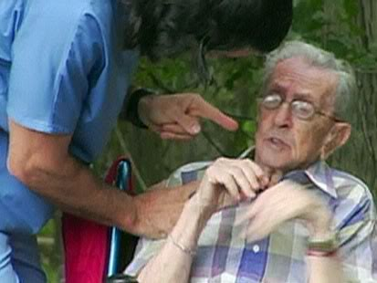
Reporting Abuse
You see or suspect another CNA abusing a resident
Report this immediately to the charge nurse
Facility will investigate according to their policies and procedures
If validated, a report will be made to the Nurse Aide Training Competency Evaluation Program (NATCEP)
NATCEP will investigate and decide whether or not to mark the CNA’s record that they were abusive

Slide 8
Ombudsman
Advocate for Residents’ Rights and quality care
Educate consumers and care providers
Investigate and resolve complaints
Appear in court and/or legal hearings
Work with investigators from the police, adult protective services, and health departments to resolve complaints
Give information to the public

Slide 9
HIPAA & You
It’s your job
To Protect residents’ health information
Confidentiality
Health Insurance Portability and Accountability Act (HIPAA)
Protected health information (PHI)
Health Information Technology for Economic and Clinical Health (HITECH)
Penalties

Slide 10
Advance Directives
Advance Directives
Living will
Durable power of attorney (for healthcare)
Patient Self-Determination Act (PSDA)
Choose the medical care you wish to receive if you are unable to make decisions
Choose someone to make medical decisions if you are unable to make decisions
Encourages people to make decisions about advance directives

Slide 11
Review
Ethics & Law
OBRA
Residents’ Rights
Abuse & Neglect
Reporting abuse
HIPAA
Advance Directives & PSDA

