Slide 1
Human Needs and Human Development
Chapter 8

Slide 2
Learning Objectives
Identify basic human needs
Explain why independence and self-care are important
Identify ways to assist residents with sexual, spiritual, and emotional needs
Describe the need for activity
Discuss family roles and significance in health care
Describe the stages of human growth and development, including the normal aging process
Explain developmental disabilities and care guidelines

Slide 3
Basic Human Needs
Physical Needs
Psychosocial Needs
Holistic Care

Slide 4
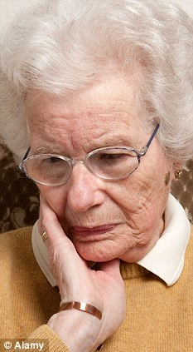
Independence
Promote Independence
ADLs
Bathing
Dressing
Toileting
Eating
Drinking
Moving
Brushing
Encourage them
Be patient
Allow them to make choices
Losing
Independence

Slide 5
Other Needs
Sexual Needs
Knock and wait
Spiritual Needs
Emotional Needs
Offer support and encouragement
Provide privacy
Respect religious items
Listen
Refer
Respect religious dietary practices
Listen
Do Not Disturb
Judgmental
Disrespectful
Judge
Interfere
Cliches

Slide 6
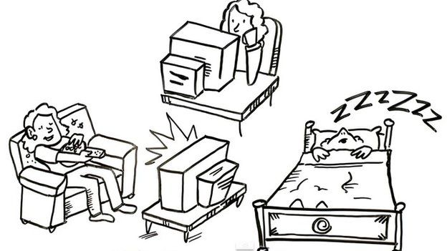
Activity
Overall improved
body function
Regular Activity
↓ Heart Disease
↓ Colon Cancer
↓ Diabetes
↓ Falls
Inactivity or Immobility
Loss of self-esteem
Depression
Boredom
Pneumonia
UTI
Constipation
Blood clots
Decreased senses
Improved ability to cope with stress
Improved sleep quality
Better eating habits
Increased energy

Slide 7
Family
Family
Nuclear
Single-Parent
Couple
2 parents + child(ren)
1 parent + child(ren)
Married or committed
Extended
Parents, children, grandparents, aunts, uncles, cousins, friends
Blended
Divorced or widowed parents remarried + child(ren)
Families Help!
Make care decisions
Communicate with the care team
Give support and encouragement
Connect them to the outside world
Offer assurance

Slide 8
Growth and Development
Infant
Toddler
Preschooler
Pre-adolescence
School-ager
Birth to 12 months
Ages 1-3
Ages 3-6
Ages 6-10
Ages 10-13
Adolescence
Ages 13-19
Young adulthood
Ages 19-40
Middle adulthood
Ages 50-65
Late adulthood
Ages 65 +

Slide 9
Aging
Normal
Skin changes
Weaker muscles
Abnormal
Signs of depression
Loss of logical thinking
Slower reflexes
Short-term memory loss
Decreased appetite
Weaker immune system
Poor nutrition
Shortness of breath
incontinence

Slide 10
Developmental Disabilities
Down Syndrome
Varying degrees of disability
Cerebral Palsy
Brain damage in utero or during birth
Spina Bifida
Part of the backbone is not well-developed at birth
Autism
Intellectual Disability
Most common developmental disorder
Below-average development and mental function
Physical symptoms
May have both physical and mental disabilities
Range of disabilities
Appears in childhood and continues throughout life (boys > girls)
Problems with communication and social skills

Slide 11
Review
Basic human needs
Independence
Sexual, spiritual, and emotional needs
Activity
Family
Growth and development
Aging
Developmental disabilities

