Slide 1
The Resident’s Unit
Chapter 12

Slide 2
Learning Objectives
Explain why a comfortable environment is important for the resident’s well-being
Describe a standard resident unit
Discuss how to care for and clean unit equipment
Explain the importance of sleep and factors affecting sleep
Describe bedmaking guidelines and perform proper bedmaking

Slide 3
A Comfortable Environment
Promoting Comfort
Keep the noise level low
Control odors
Maintain comfortable temperature
Proper lighting
Monitor food preferences
Listen to residents’ concerns
71-81° F

Slide 4
Standard Resident Unit
disposable

Slide 5
Sleep
circadian rhythm
Lack of sleep
Decreased
Increased irritability
mental function
reaction time
immune system function
Repair and renew cells
Process information
Organize memory

Slide 6
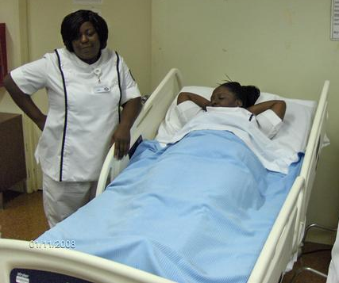
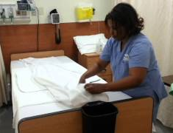
Bedmaking
Change linens when soiled, wrinkled, or damp
Damp and wrinkled
Damp or soiled
Uncomfortable
Infection
Wrinkled
Pressure ulcers
occupied
unoccupied
Do NOT shake
Do NOT take to another resident room
Roll dirty side in (away from you)
Carry linens away from your body
closed
open

Slide 7
Review
Comfortable environment
Standard resident unit
Caring for equipment
Sleep
Bedmaking

