Slide 1
Urinary Elimination
Chapter 16

Slide 2
Learning Objectives
List qualities of urine and identify signs and symptoms about urine to report
List factors affecting urination and demonstrate how to assist with elimination
Describe common diseases and disorders of the urinary system
Describe guidelines for urinary catheter care
Identify types of urine specimens that are collected
Explain types of tests performed on urine
Explain guidelines for assisting with bladder retraining

Slide 3
Normal Urination
Normal Urination
Light, pale yellow
Clear or transparent
Faint odor
1200-1500mL per day
Factors that may affect normal urination
Normal aging changes
Psychological factors
Fluid intake
Medications
Disorders or illnesses

Slide 4
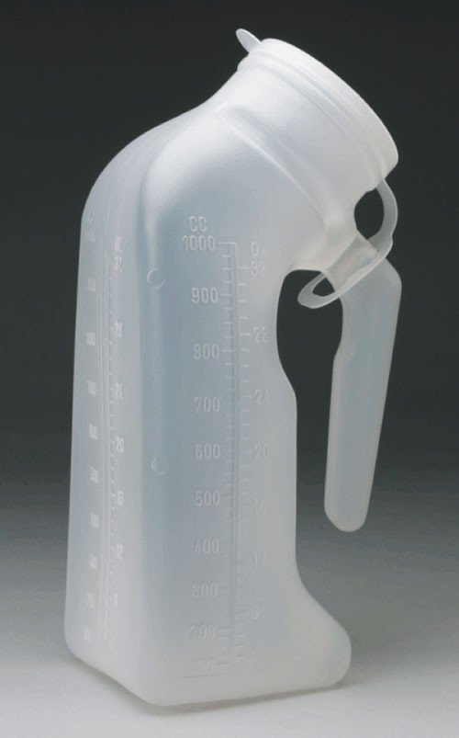
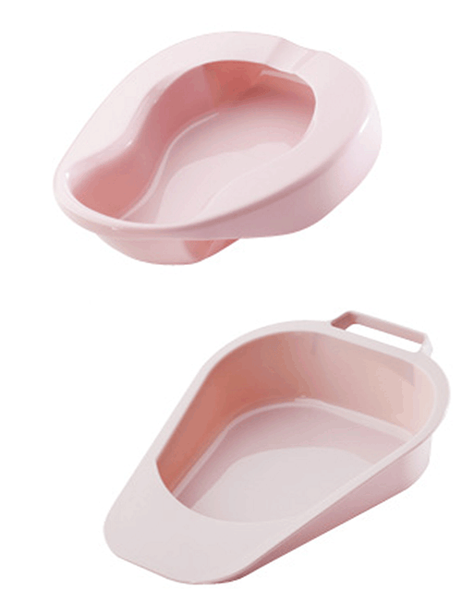
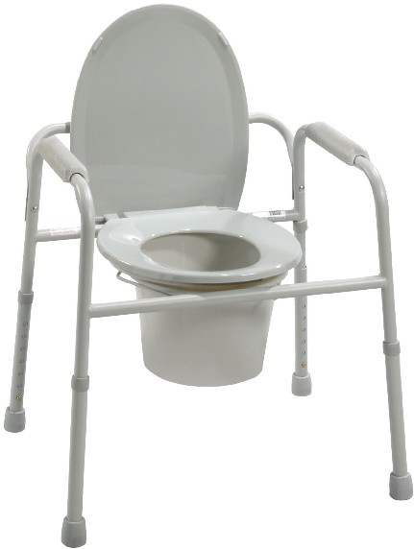
Bedpans and Urinals
skills video
standard
fractured

Slide 5
Common Diseases and Disorders
Urinary Incontinence
Involuntary loss of urine
Different types
Urinary Tract Infection (UTI – also known as cystitis)
Inflammation of the bladder and ureters
Pain, burning, frequency
Others (refer to textbook)
Calculi
Nephritis
Follow toileting schedule
Do NOT refer to pad or brief as a diaper
Be professional and kind
More common in women
Wipe FRONT TO BACK
Renovascular hypertension
Chronic renal failure
Kidney dialysis

Slide 6
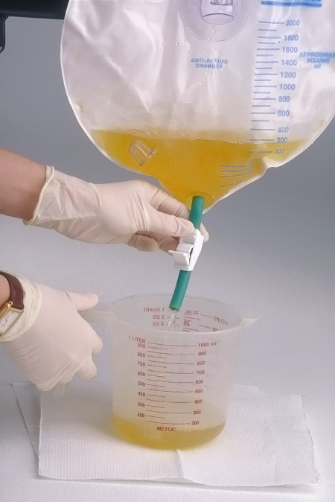
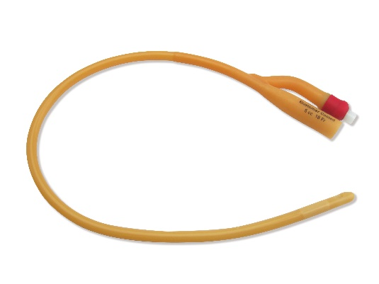
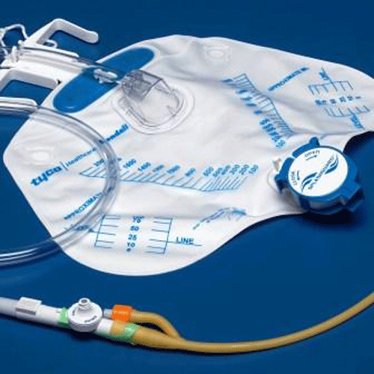
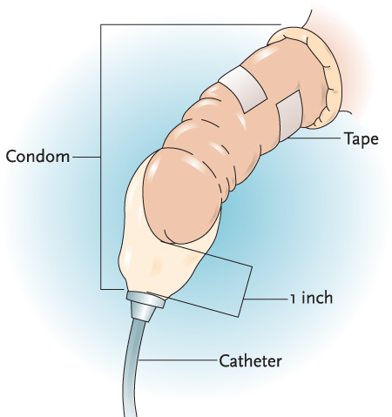
Urinary Catheter
skills video
Insert, irrigate, remove
Observe and report
Empty regularly
Keep clean

Slide 7
Urine Specimens
Routine
Collected any time the resident voids
Collected in bedpan, urinal, commode or hat
Clean-catch (mid-stream)
Clean perineal area first – void a small amount in toilet – void into container – finish in toilet
First and last urine NOT included in sample
24-hour
Collects all urine voided in a 24-hour period
Void and discard first urine so collection begins with empty bladder
Dip strip

Slide 8
Bladder Retraining
Injury, illness, or inactivity
Loss of normal bladder function
Re-establish regular routine or normal function
Be positive and professional

Slide 9
Review
Urine qualities
Factors affecting urination
Assisting with elimination
Common urinary diseases and disorders
Urinary catheter care
Urine specimens
Bladder retraining

