Slide 1
Admitting, Transferring and Discharging
Chapter 11

Slide 2
Learning Objectives
Describe how residents may feel when entering a facility
Explain the CNA role in the admission process
Explain the CNA role during an in-house transfer of a resident
Explain the CNA role in the discharge of a resident
Describe the CNA role in physical exams

Slide 3
The Admission Process
Prepare the room
Note the time and condition
Introductions
Do NOT rush
Explain facility activities
Respect personal items
Place personal items where the resident wants them
Explain the call light, bed controls, telephone, lights and TV
Provide fresh water
Make sure the resident is comfortable
Fear
Uncertainty
Anger
Loss

Slide 4
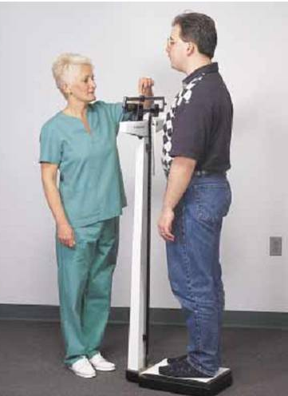
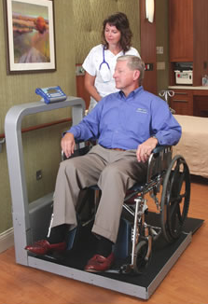
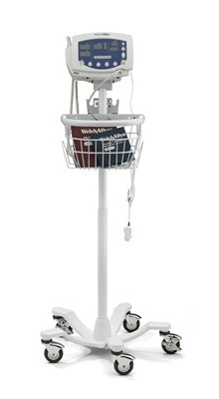
Height, Weight and Baseline Vital Signs
H
E
I
G
H
T
WEIGHT
ZERO
Baseline vital signs

Slide 5
Transfers and Discharges
Work together
Nurse will inform resident
You will help the resident pack
Out of Facility Transfer
In-House Transfer
Work together
Nurse will inform resident
Clean and appropriate clothing
Tidy room
Help resident settle into the new room
Discharge
Doctor’s order
Nurse reviews instructions with resident and family
You can help the resident pack
Be positive and offer assurance

Slide 6
Physical Exams
You may be asked to:
Gather equipment
Bring residents to the proper area
Provide emotional support
Cover the resident
Do NOT expose them more than necessary for the exam
Be sensitive
Explain why the position is needed and how long it will take
position and drape

Slide 7
Review
How a resident feels when entering a facility
Your role in the admission
Your role in the transfer and discharge process
Your role in physical exams

