Slide 1
Preventing Infection
Chapter 5

Slide 2
Learning Objectives
Define infection prevention and discuss types of infections
Describe the chain of infection
Explain why the elderly are at a higher risk for infection
Explain Standard Precautions
Explain how to handle spills
Explain Transmission-Based Precautions
Define bloodborne pathogens and explain OSHA’s Bloodborne Pathogens Standard

Slide 3
Infection Prevention
Nosocomial Infection
Set of methods practiced in healthcare facilities to prevent and control the spread of disease
Localized infection
Pain
Redness
Systemic infection
Fever; Body aches; Chills
Pus
Swelling
Drainage
Warm to touch
Nausea; Vomiting
Weakness
Headache
Mental confusion
Drop in blood pressure
Microbe
Microorganism
Pathogen
Harmful microbe
Infection
Pathogens invade the body and multiply
Visible under microscope
Always present

Slide 4
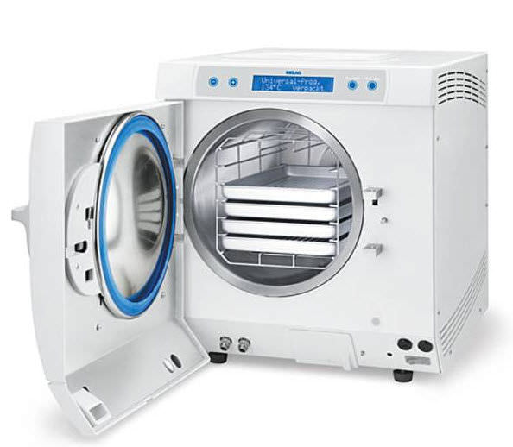
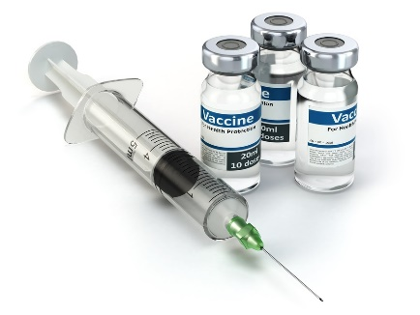
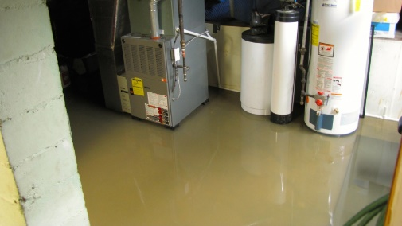
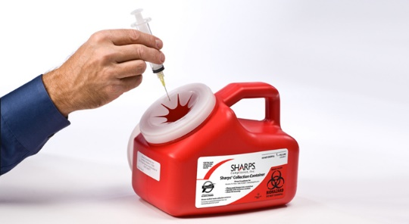
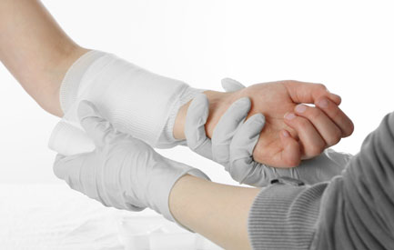
The Chain of Infection
Chain of Infection
Causative Agent
Reservoir
Portal of Exit
Mode of Transmission
Portal of Entry
Susceptible Host

Slide 5
Elderly and Infection
Increased risk
Malnutrition
Dehydration
Weakened immune systems
Decreased circulation
Slow wound healing
Limited mobility
Hospitalization
Difficulty swallowing
Incontinence
Feeding tubes and other tubing

Slide 6
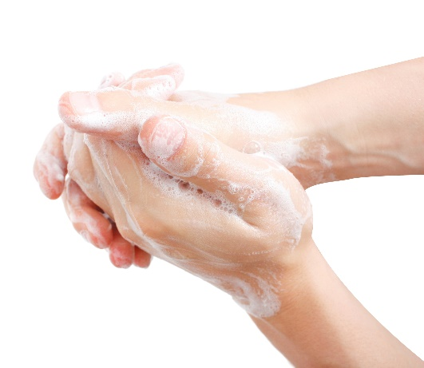
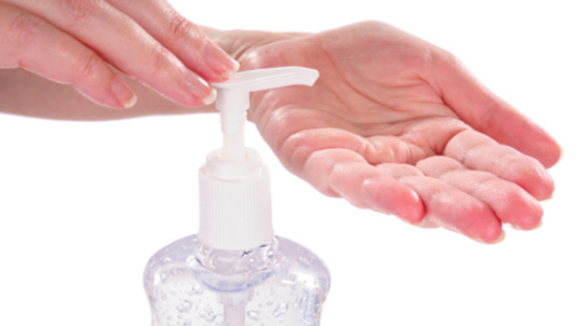
Standard Precautions for EVERY resident
Don
Doff
PPE

Slide 7
Proper Handling
Put on gloves
Absorb spill
Dispose in container
Apply disinfectant
Use cleaning solution
Use tools to pick up glass
Properly bag waste
Spills happen
Clean
Dirty
Disinfection
Sterilization
Disposable

Slide 8
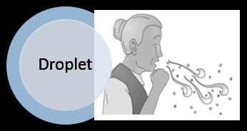
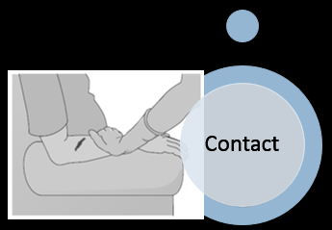
Transmission-based Precautions
Methods of preventing infection when caring for a person who is infected or suspected of being infected with a disease
Use IN ADDITION to Standard Precautions
MDRO
MRSA
Spread by direct physical contact
Proper handwashing
VRE
Spread by direct and indirect contact
Proper handwashing & PPE

Slide 9
Bloodborne Pathogens
Bloodborne Pathogens Standard
Employer Responsibilities
Transmission
Infected blood, semen or vaginal secretions
Sexual contact
Needle sharing
Infected mothers
Contact with infected blood or body fluids
Written exposure control plan
Provide proper PPE
Provide biohazard containers
Offer FREE hepatitis B vaccine
Affix warning labels to containers
Log of injuries
Provide in-service training
HIV
Hepatitis

Slide 10
Review
Infection
Standard Precautions
Spills
Transmission-Based Precautions
Bloodborne Pathogens
Bloodborne Pathogens Standard

