Slide 1
Nutrition and Hydration
Chapter 15

Slide 2
Learning Objectives
Discuss proper nutrition, including MyPlate
Identify nutritional problems of the elderly or ill as well as food preferences
Explain the role of the dietary department
Explain special diets and thickened liquids
Explain how to serve meal trays and assist with eating, including residents with special needs
Explain I&O and ways to maintain fluid balance

Slide 3
Proper Nutrition
6 basic nutrients
Water
Most essential nutrient
64oz daily
Aids in: digestion, food absorption, elimination, maintaining body temperature
Carbohydrates
Provide energy, extra protein and fiber
Simple carbs (sugars, sweets) less nutritious than Complex carbs (bread, vegetables)
Proteins
Essential for tissue growth and repair and energy
Sources include fish, poultry, meat, eggs, soy or plant-based products (tofu)
Fats
Store energy, provide insulation, protect organs
Sources include butter, oils, fats
Mono- and poly-saturated fats are healthier than saturated fats
Vitamins
Essential for body functions
Fat-soluble – A, D, E, K
Water-soluble – B & C
Minerals
Form and maintain body functions
Zinc, iron, sodium, potassium, calcium, magnesium, phosphorus

Slide 4
MyPlate
fat-free or low-fat (1%)
whole
Balance your calories
Enjoy your food, but eat less
Avoid oversized portions
Eat these more often:
vegetables, fruit, whole grains, and fat-free or low-fat (1%) dairy products
Eat these less often:
foods high in fat, sugar, and salt
Drink water
50%
lean

Slide 5
Nutritional Problems & Preferences
Aging
Slower metabolism
Reduced activity
Unintended weight loss
Tube feedings
TPN
Nasogastric
PEG
Food preferences

Slide 6
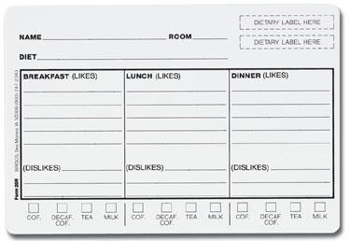
Special Diets
Dietary
department
Low-sodium
Fluid-restricted
High-potassium
Low-protein
Low-fat / Low-cholesterol
Modified calorie
Bland
Diabetic
Low-residue (low-fiber)
High-residue (high-fiber)
Gluten-free
Vegetarian
Liquid
Soft and Mechanical soft
Pureed
Lacto-ovo
Lacto-vegetarian
Ovo-vegetarian
Vegan
Clear
Full
Thickened (nectar-honey-pudding)

Slide 7
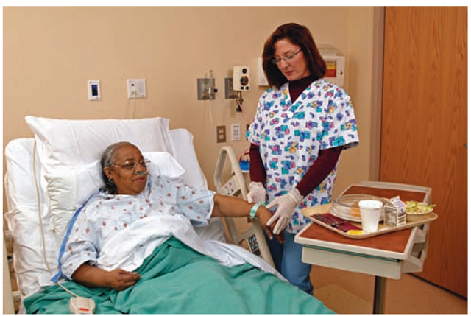
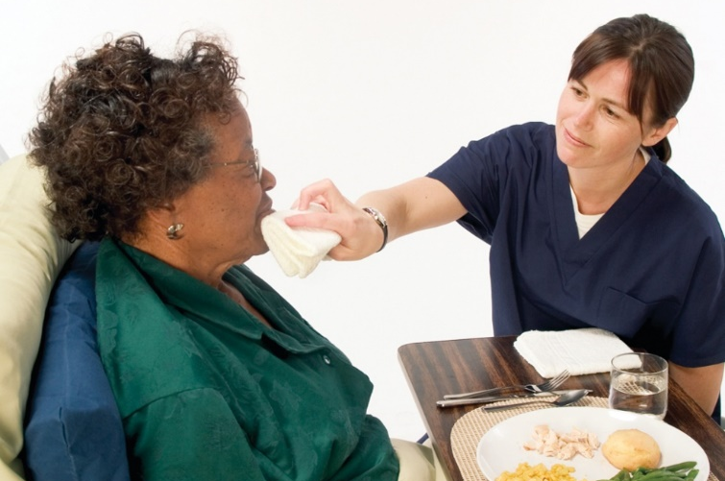
Mealtimes
skills video
Social interaction
Identify resident
Observe and record
Encourage participation
Identify foods and fluids
Sit at eye level
Position upright at 90 degrees
Offer clothing protector
Do NOT rush

Slide 8
Special Assistance
Conditions
Stroke
Special Assistance
Physical cues
Verbal cues
Imaginary clock to explain position
Food in stronger side
Dysphagia
Difficulty swallowing
Coughing or choking during meals; dribbling; eating slow; watering eyes during meals
Increased risk for aspiration
Parkinson’s
Dementia
Blind
Confused

Slide 9
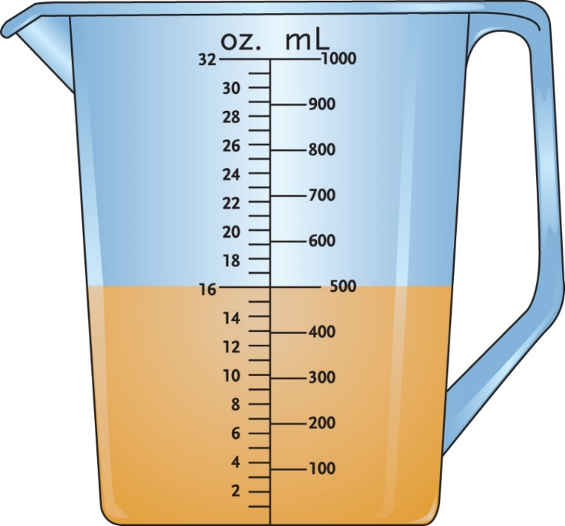
Intake & Output (I&O)
→
skills video
1mL = 1cc
Convert oz. to mL
# oz. x 30 = mL
1oz = 30mL
Intake
Output
Fluid consumed
Fluid eliminated
NPO
Force or Restrict Fluids
Fluid overload
Dehydration
FLUID BALANCE

Slide 10
Review
Proper nutrition
Problems and preferences
Dietary department
Special diets
Mealtimes and assistance
Fluid balance

