Slide 1
Bowel Elimination
Chapter 17

Slide 2
Learning Objectives
List qualities of stool and identify signs and symptoms about stool to report
List factors affecting bowel elimination
Describe common diseases and disorders of the GI system
Discuss how enemas are given
Demonstrate how to collect a stool specimen and explain occult blood testing
List care guidelines for an ostomy
Explain guidelines for assisting with bowel retraining

Slide 3
Normal Bowel Elimination
Normal Bowel Elimination
Brown, soft, tubular shape
Bowel movement (BM)
Factors that may affect normal bowel elimination
Normal aging changes
Psychological factors
Foods and fluids
Medications
Personal habits

Slide 4
Common Diseases and Disorders
Constipation
Fecal Impaction
Hemorrhoids
Diarrhea
Fecal Incontinence
Flatulence (gas)
GERD
Peptic Ulcers
Ulcerative Colitis
Colorectal Cancer

Slide 5
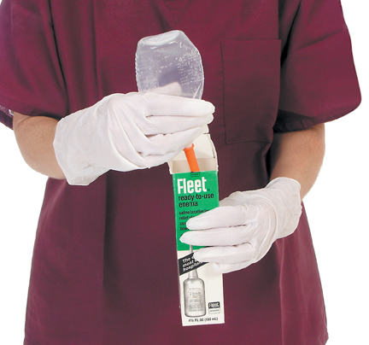
Enema
Keep the bedpan close or bathroom pathway clear
Assist resident to Sims’ position
Lubricate tip of tube
Encourage slow, deep breaths
Bottom of enema bag should not be more than 12” above anus

Slide 6
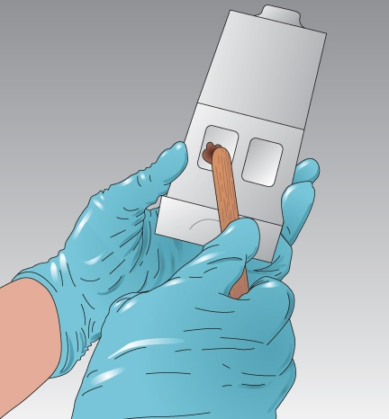
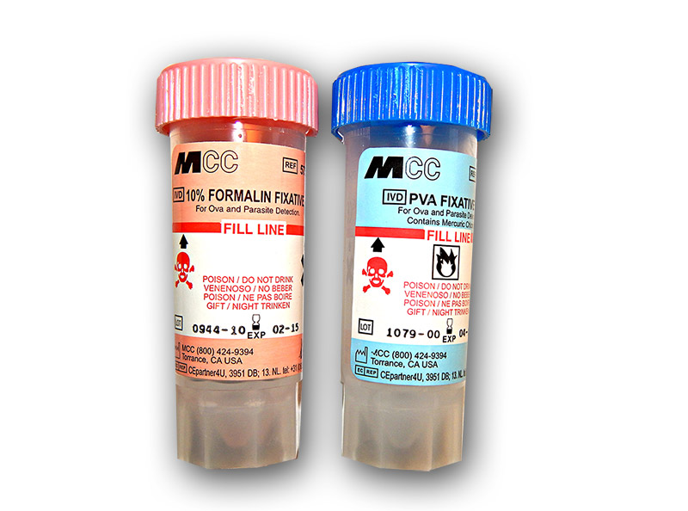
Stool Specimens
occult
warm for O&P
urine or tissue

Slide 7
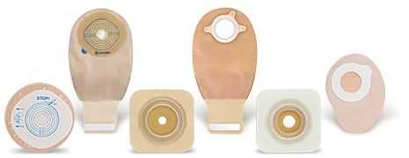
Ostomy
Ostomy
Surgical creation of an opening from an area inside the body to the outside
Opening is called a stoma
Drainage bag (appliance)

Slide 8
Bowel Retraining
Injury, illness, or inactivity
Loss of normal bowel function
Re-establish regular routine or normal function
Be positive and professional

Slide 9
Review
Stool qualities
Factors affecting bowel elimination
Common diseases and disorders of the GI system
Enemas
Stool specimens
Ostomies
Bowel retraining

