Slide 1
Basic Nursing Skills
Chapter 14

Slide 2
Learning Objectives
Explain the importance of monitoring vital signs
List guidelines for measuring body temperature, pulse, and respirations, and blood pressure
Describe guidelines for pain management
Explain the benefits of warm and cold applications
Discuss sterile and non-sterile dressings and elastic bandages
List care guidelines for a resident with an IV
Discuss oxygen therapy and explain related care guidelines

Slide 3
Vital Signs
Vital Signs
Temperature
Pulse
Blood Pressure
Pain Level
Respirations
Watch for changes
Take accurate measurements
Report abnormal measurements

Slide 4
Body Temperature
Variety of Sites
Oral
Rectal
Thermometers
Color-Coded
Various Types
Axilla
Tympanic
Temporal
Normal Range
97.6-99.6F
Fahrenheit vs Celsius

Slide 5
Pulse and Respirations
skills video
Pulse
respirations
Heart beats per minute (bpm)
Pulse points *radial*
Normal rate 60-100bpm
Inspiration
Expiration
Respiration
1 rise
1 fall
1 respiration
12-20 breaths per minute

Slide 6
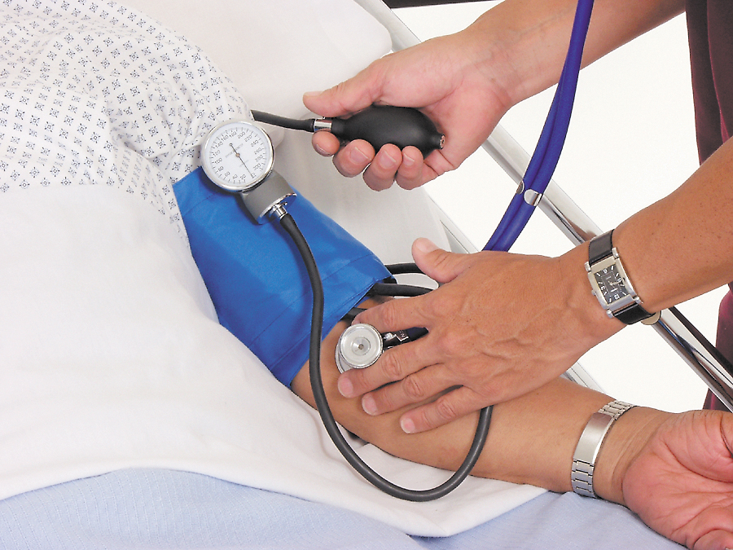
Blood Pressure
skills video
Sphygmomanometer
100-119mmHg 60-79mmHg
Hypertension
Hypotension
Manual or electronic

Slide 7
Pain
Pain
5th vital sign
Individual experience
NOT a normal part of aging
Body language
Observe and report
Help reduce pain

Slide 8
Warm and Cold Applications
Applications
Warm
Cold
Moist
Dry
Relieve pain and muscular tension
Reduce swelling and increase blood flow
Help stop bleeding
Prevent swelling, reduce pain, and bring down high fevers
Strengthen the effect of warm or cold applications
Compresses, soaks, tub baths, sponge baths, sitz baths, ice packs
Observe and report excessive redness, pain, blisters, or numbness
K-pad, electric heating pads, disposable warm or cold packs, and ice bags

Slide 9
Dressings and Bandages
Sterile Dressings
Non-sterile Dressings
Elastic Bandages

Slide 10
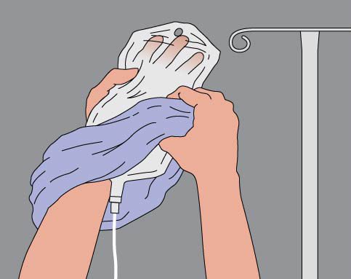
IV and Oxygen Therapy
IV
frostbite
fire hazard

Slide 11
Review
Vital Signs
Measuring
Body temperature
Pulse and respirations
Blood pressure
Pain and applications
Dressings and bandages
IV and oxygen therapy

