Slide 1
The Healthy Human Body
Chapter 9

Slide 2
Learning Objectives
Describe body systems and define key anatomical terms
Describe each of the body systems:
Integumentary
Musculoskeletal
Nervous
Circulatory
Respiratory
Urinary
Gastrointestinal
Endocrine
Reproductive
Immune and lymphatic

Slide 3
Body Systems and Anatomical Terms
Homeostasis
Body systems
Organs
Tissues
Cells

Slide 4
Integumentary System
What does it do?
Largest organ and system
How does it change?
Thinner, drier, fragile, itchy
How can you help?
Protective covering
Sense organ
Thinner, gray hair
Wrinkles and brown spots
Brittle nails
Thinning fatty tissue
Lotion
Be gentle
Layer clothing
Do NOT cut toenails
Encourage fluids

Slide 5
Musculoskeletal System
What does it do?
Muscles, bones, ligaments, tendons, and cartilage
How does it change?
Muscles weaken and lose tone
How can you help?
Prevent falls
Move the body, protect organs, provide heat
Slower body movement
Brittle bones
Stiff and painful joints
Loss of height
Promote self-care
Encourage regular movement
206

Slide 6
Nervous System
neuron
What does it do?
Control and message center
How does it change?
Slower responses and reflexes
How can you help?
Allow time
CNS and PNS
Decreased sensitivity
Short-term memory loss
Avoid sudden changes
Do NOT rush
Encourage mental stimulation

Slide 7
Sense Organs (part of the Nervous System)
What does it do?
Contain receptors that relay information to the nerves
How does it change?
Decreased vision, hearing and senses
How can you help?
Keep eyeglasses and hearing aids clean
Sense of balance
Proper lighting
Speak slow and clear
Repeat words when needed
Use caution with hot drinks and hot bath water
Eyes
Ears
Nose
Tongue
Skin

Slide 8
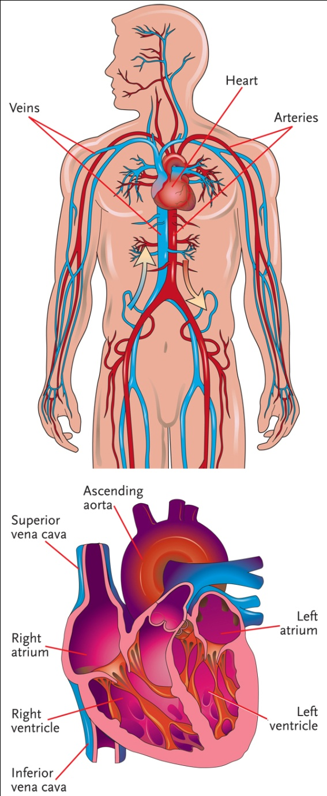
Circulatory System
Diastole
Systole
What does it do?
Heart, blood vessels, and blood
How does it change?
Less efficient pumping
How can you help?
Encourage movement
Supplies food, oxygen and hormones to cells
Decreased blood flow
Narrowed blood vessels
Assist with ROM
Allow time
Warmth

Slide 9
Respiratory System
Inspiration
Expiration
Respiration
What does it do?
Nose, trachea, bronchi, lungs
How does it change?
Decreased lung strength and capacity
How can you help?
Encourage movement
Oxygen and carbon dioxide exchange
Decreased oxygen in blood
Weakened voice
Rest periods
Deep breathing exercises
Assist to sit up

Slide 10
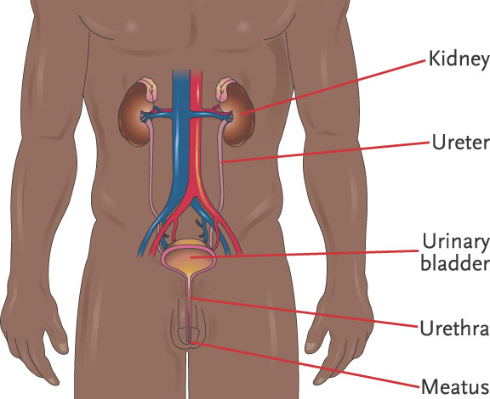
Urinary System
What does it do?
Kidneys, ureters, bladder, urethra, meatus
How does it change?
Decreased kidney function
How can you help?
Encourage fluids
Eliminate waste
Maintain water balance
Weakened bladder
Increased risk of infection
Offer frequent trips to bathroom
Do NOT get frustrated
Keep clean and dry
UTI

Slide 11
Gastrointestinal System
peristalsis
digestion
elimination
What does it do?
GI tract and accessory digestive organs
How does it change?
Decreased saliva production
How can you help?
Encourage fluids and nutritious meals
Allow time
Peristalsis, digestion, elimination
Dulled sense of taste
Decreased absorption
Longer digestion
Slower elimination
Regular oral care

Slide 12
Endocrine System
hormones
What does it do?
Glands in different areas of the body
How does it change?
Decreased hormone levels
How can you help?
Encourage proper nutrition
Maintain homeostasis
Decreased insulin levels
Decreased ability to handle stress
Eliminate or reduce stressors
Offer encouragement and listen

Slide 13
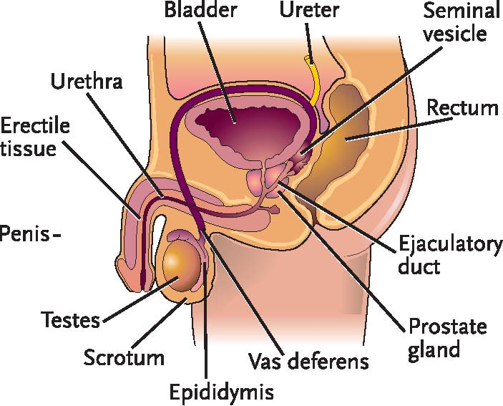
Reproductive System
What does it do?
Reproductive organs
How does it change?
Men: decreased sperm production and enlarged prostate
How can you help?
Provide privacy
Allows reproduction
Women: menopause, decreased estrogen, brittle bones, drier and thinner vaginal walls
Respect sexual needs
Report inappropriate behavior
Male Reproductive System

Slide 14
Immune and Lymphatic Systems
nonspecific
specific
antibodies
What does it do?
Immune
How does it change?
Weakened immune system
How can you help?
Infection prevention
Protects the body from disease
Lymphatic
Removes excess fluids and waste from tissues
Decreased number and size of lymph nodes
Decreased vaccine response
Encourage proper nutrition and fluid intake
Take accurate vital signs
lymph

Slide 15
Review
Organization of the body
Anatomical terms
Various body systems
What they do
How it changes
How you can help

