Slide 1
Positioning, Transfers and Ambulation
Chapter 10

Slide 2
Learning Objectives
Review the principles of body mechanics
Explain positioning and describe how to safely position residents
Describe how to safely transfer residents
Discuss how to safely ambulate residents

Slide 3
Body Mechanics
Assess the load
Think ahead, plan and communicate
Check your base of support
Face what you are lifting and keep it close to your body
Keep your back straight and tighten your stomach muscles
Begin in a squatting position and lift with your legs
Push when possible, rather than lift

Slide 4
Positioning
supine
lateral
every 2 hours
prone
Fowler’s
semi high
every hour
Sim’s

Slide 5
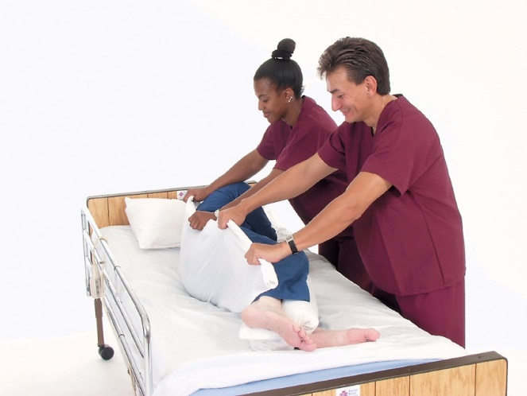
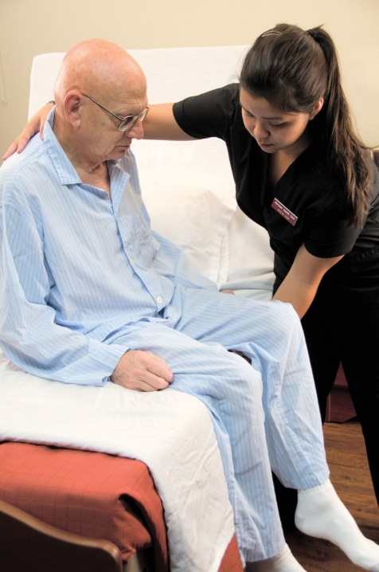
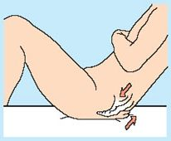
Positioning
logrolling
Adjust the bed
Lock the bed brakes
Proper body mechanics
shearing
draw sheet
dangle

Slide 6
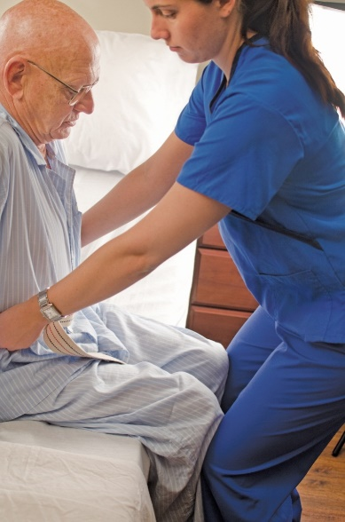
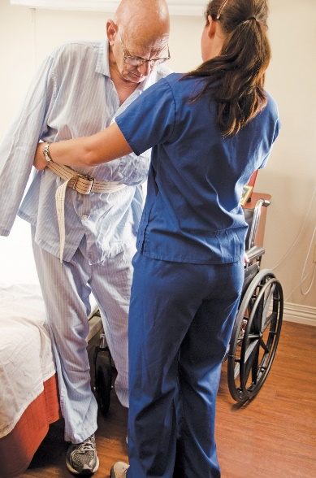
Transfers
Mechanical Lifts
Safety
Transfer/gait belt
Strong side first
Lock brakes
Proper body mechanics
Footwear

Slide 7
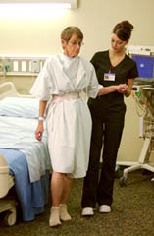
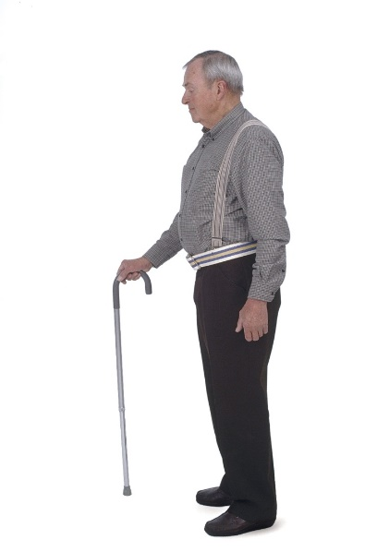
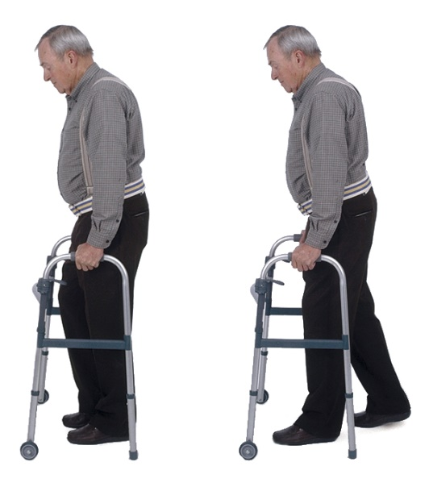
Ambulation
Canes
Walkers
Using assistive devices
Good condition
Non-skid footwear
Cane on the STRONGER side
Both hands on walker
You stay near the weaker side
Care plan

Slide 8
Review
Body Mechanics
Positioning
Transfers
Ambulation

